Slide 1
Digital Storytelling Apertures
Green Screens and Beyond
Dr. Julie Delello, Associate Professor
School of Education

Slide 2
Digital Stories
Use Computer-Based Tools to Tell Stories
Combination of videos, images, sound/music
Retell historical events
Memoirs, personal essays, interactive storytelling
Make your lessons more meaningful

Slide 3
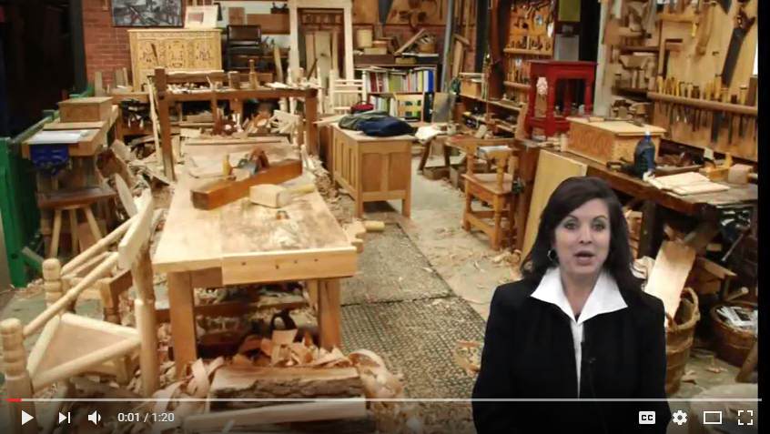
Example of Digital Story

Slide 4
Getting Started With Green Screening
On your iPad, download the images that you will want to use for a background. These need to be clear (no blurred edges) and check for copyrights. You can simply download from the Internet or upload your own.
Lighting is important. Shadows or poor light may cause difficulties removing the green background.

Slide 5
Recording Your Video
Make sure the volume is turned up all the way if you record on your iPad. An external microphone may help.
Wear a color that is not green, red, or tan (black works well) (or blue if using the blue screen)
You will need to stand or sit in front of the green (or blue) screen.
Record your video using your favorite application, camera, or computer program.
Upload your video to your iPad (Dropbox, One Drive…)

Slide 6
Easy Green Screen Applications
DoInk
Download the DoInk App. $2.99
Open the DoInk App.
Choose your background image
Add your recorded video
Filter colors, Trim- Edit
Save and Upload

Slide 7
Three rows in DoInk
Select the bottom plus (right hand corner) to choose your background.
Select the middle plus to bring in your video recording or image. You can resize the image by using two-fingers to enlarge or reduce. You can crop the image by using the resize tool. Note the third plus is if you want to bring in clipart on your image.
Click on your green screen video (second line). The colored circle is the Chroma filter. This is your friend. You will want to play with the sensitivity until you can’t see the green screen behind you anymore but instead your new background with you in front of it. This takes some practice.

Slide 8
Combining it All
Click the arrow key to play the new video. The X button will delete everything and allow you to start completely over. The mask button will allow you to erase a portion of your image.
If you have not already trimmed and want to trim the front or the end of the video, just slide the red dots on the timeline to the place where you want it to start/end.
Hit SAVE when finished. You project will be exported. Save it to the camera roll.

Slide 9
Example of Video in DoInk

Slide 10
Closed-Captioning in YouTube
To close caption your video and share it in Blackboard, export/upload your video to YouTube using the upload box/arrow. Note: Create a YouTube account if you do not have one.
Once uploaded, click the edit button.
The CC button will allow you to upload your script. I usually just click the language (English) and transcribe and auto-sync.
Under enhancements, you can choose filters that really help make your video a success and hide any flaws. You can also TRIM it here too.

Slide 11
YouTube Editing/Closed Captioning
SAVE it and embed the URL or EMBED code in Blackboard.

Slide 12
Veescope Live Green Screen App
Free Light Version/$2.99 Full (MAC, iPad, iPhone, iPod)

Slide 13
Using TouchCast Studio
Free Version

Slide 14
Your Turn
Each table group has an iPad and Green Screen to try making a short 5 minute video using one of the applications we looked at. If time, we will share your creations!

