Slide 1
Campus Carry Guidelines
The University of Texas at Tyler

Slide 2
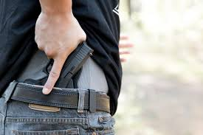
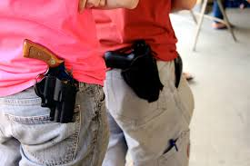
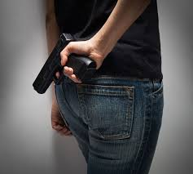
Firearm Carry Methods Defined
Concealed Carry - concealed weapons are weapons, especially handguns, which are kept hidden on one's person, or under one's control. Carrying a concealed weapon is illegal in most states unless the party with the weapon is a law enforcement officer or has a permit to carry a concealed weapon.
Open Carry - In the United States, open carry refers to the practice of "openly carrying a firearm in public", as distinguished from concealed carry, where firearms cannot be seen by the casual observer. Open carry is never allowed on university property!
Printing- The informal term “printing” refers to showing an outline of a concealed carry gun on either a shirt or garment that the person is wearing. This is a gray area, but is typically not a cause for concern since it can’t usually be absolutely identified as a gun and not a cell phone, etc.
Brandishing-There is no big difference between improper exhibition and brandishing for many states. In both cases, it's the demonstration of intent to intimidate by revealing a weapon. It is seen as a reckless step towards the escalation of a conflict by showing a firearm. Anyone who sees your gun leave its holster has the beginning of a case of improper exhibition – especially if there was an argument or altercation previous to the event.

Slide 3
How Is A “License to Carry” Obtained?
To be eligible to apply for the course you must:
Have been a legal resident of Texas for at least six months.
Be at least 21 years old.
Must not be a convicted felon.
Not be charged with the commission of a Class A or Class B misdemeanor or equivalent offense.
To Apply to take the course you must:
1. Pay a class fee. (Usually 75-100 dollars)
Be fingerprinted and have those filed with the state.
Complete a background check with Texas Department of Public Safety.
Have basic firearms proficiency.
To complete the course you must:
Complete a 6-hour course and pass a written test on that material.
Pass a live-fire instruction and qualification test on a shooting range.

Slide 4
U.T. Tyler Campus Carry Policy
The UT Tyler Concealed Handguns on Campus Policy has been approved by the University of Texas System Board of Regents and will go into effect at all UT Tyler facilities beginning Aug.1, 2016.
Senate Bill 11 authorizes handgun license holders to carry their concealed handguns on campus and also requires each university to develop specific guidelines regarding campus concealed carry.
Under UT Tyler's policy, which was developed through an extensive process led by the Campus Carry Working Group, all licensed handgun carriers will be required to carry the handgun in a holster or other secure weapon case that completely covers the trigger and the entire trigger guard area. The holster must sufficiently retain the handgun in place so that it will not discharge in the event of sudden movement.
In addition, UT Tyler's policy categorizes certain areas as exclusion zones, where the concealed carrying of a handgun is prohibited. Signs will be posted at the entry points of areas identified in the policy as exclusion zones. Exclusion zones include all or part of certain buildings. Specific areas are detailed in UT Tyler's Concealed Handguns on Campus Policy , found on the U.T. Tyler web site.
Exclusion zones will include:
•UT Tyler Innovation Academy in Tyler, Palestine and Longview.
•Patient care areas such as the University Health Clinic, counseling rooms (located in portions of the UC and BEP) and athletic training rooms.
•Ticketed sporting events at any of the UT Tyler's athletic facilities, as required by law.
•Formal hearing areas for employee or student adjudication (portions of ADM and UC).
•Areas where handgun discharge may cause widespread harm such as labs with dangerous and/or explosive chemicals or with magnetic resonance imaging equipment (portions of BEP, HPR, RBS and the Fine Arts Complex).
•Areas in use for sponsored activities for students under the age of 18 who are not enrolled at UT Tyler.
The University of Texas at Tyler takes issues surrounding guns on campus very seriously and will strive to conform to the new law, protect the rights of citizens, and ensure the safety and security of the entire campus. For more Information go to: https://www.uttyler.edu/about/campus-carry/

Slide 5
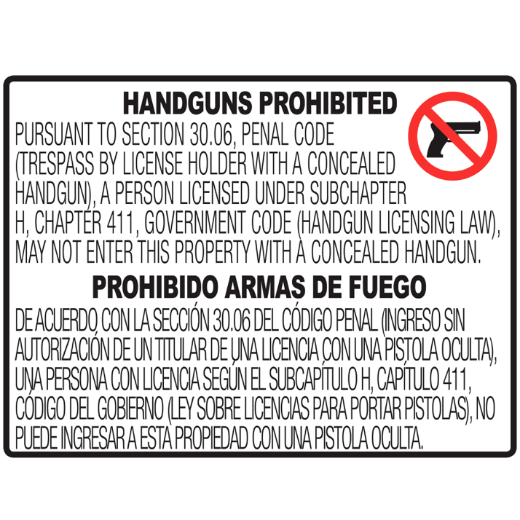
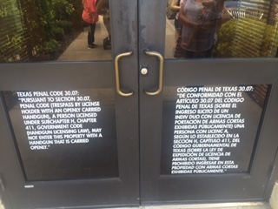
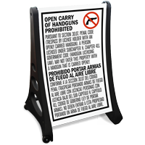
Exclusion Zones are Identified
Every U.T. system school has certain areas on campus that are off-limits to firearms. This can be for a number of reasons, which are listed here: https://www.uttyler.edu/about/campus-carry/
These areas are called “exclusion zones” and those locations will be marked with a sign to let carriers know not to bring firearms in that specific area. You might also see moveable signs placed out for a short time during special events. Other than an event, the exclusion zones do not change during a semester so that carriers are not “surprised” by a sudden appearance of a zone.
While there aren’t very many areas that are excluded, it is up to each individual to follow this law and make arrangements for their firearm during the time in one of these areas. The university does not offer storage lockers for firearms. It is recommended that you make sure your firearm is secured and not visible in your vehicle or left at home for that span of time.
This symbol displayed alone is not an official, legal prohibition of firearms and does not indicate an exclusion zone.

Slide 6
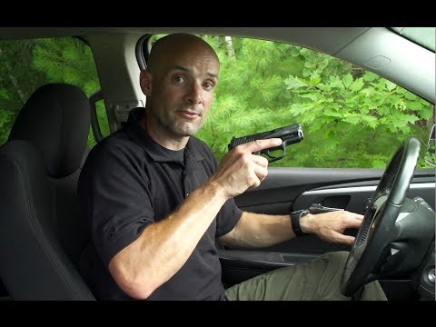
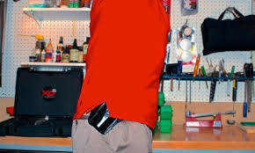
If You Observe A Firearm
As a concealed carrier, in most circumstances being spotted with a mostly concealed, holstered firearm is not usually a big deal. Perhaps the firearm and holster are quickly exposed as the carrier reaches overhead or bends to tie a shoe. If reported, it often leads to a discussion with a police officer and his determination of facts. If you are approached by an officer, keep your hands visible, remain calm, and follow the officers directions. The fact that they approach to talk to you doesn’t mean you have committed any violations. Be as cooperative as possible and everyone can be on their way much quicker and without any issues.
If you observe a firearm un-holstered, being displayed, being brandished, or generally being unsecured in any way by the individual, DO NOT CONFRONT THEM. No matter what you think their intentions are, quietly move out of the immediate area and call U.T. Tyler Police at 903-566-7300. Be prepared to give them a location and a description of the individual. Describe the situation as accurately as possible to the dispatcher, so that arriving officers understand the situation correctly. Remember the difference between printing, accidentally displaying, and brandishing the gun in a threatening way. Do not jump to conclusions about what you have seen. (see example) Once you step away and call, you are not responsible for where the individual goes. Do not follow them if they leave. Stay on the phone until the dispatcher ends the call.
Ex. Is this a time to call? Or This? How about this one?
YES TO ALL THREE!

Slide 7
RUN-HIDE-FIGHT
Remember: If an individual is brandishing a firearm in an aggressive manner or begins firing, you are now in an ACTIVE SHOOTER SITUATION and you must follow our safety procedure, “RUN-HIDE-FIGHT”.
Please watch the short video below:
RUN if you have a clear path away from the shooter.
HIDE if running isn’t an option, lock doors, turn off lights, be quiet
FIGHT if you have no other choice, preferably fighting as a group.
If video fails to load after 15 seconds, click here:
https://www.youtube.com/watch?v=5VcSwejU2D0

Slide 8
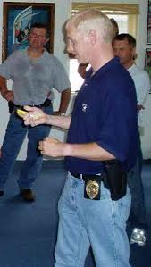
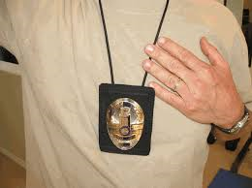
Concealed Carrier or Safety Threat ?
Most licensed carriers have been trained in liability issues. In other words, “You are responsible for everything that happens as a result of your display or use of a firearm.” Carrying a firearm is a big responsibility, and part of a license holders training is to understand what drawing, brandishing, or firing your weapon can bring about. Any injuries, deaths, property damage, and more can become your legal responsibility. Careful decisions have to be made and then lived with afterwards.
Not everyone carrying a firearm is a threat. Unfortunately the world we live in has forced us to be aware of the possibility of an active shooter, and despite it’s low occurrence rate, we still think of that first anytime we see an open carrier. Consider the following example you might be faced with on campus: What if a plain-clothes police officer is visiting campus? How do you know? What should you do? Understand that every police office when in plain clothes must wear a badge clearly visible at all times. (Often on the waist or a neck chain). If you are not able to verify this, you can follow the same procedure as usual, don’t confront them, move away and call U.T. Tyler Police Department at 903-566-7300. If the person has a badge and isn’t brandishing the weapon or acting aggressively, the call isn’t necessary.

Slide 9
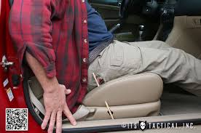
Accidental / Negligent Discharge
One reason U.T. Tyler policy requires proper holstering of a firearm is to avoid what is known as an accidental or negligent discharge.
These discharges are generally from improperly handling a firearm, whether attempting to multi-task, not using a proper holster, or other unsafe behavior. Often in a negligent discharge a person will claim “It just went off by itself.” Of course we know this isn’t really possible, but it was a shock to them because their careless handling caused the gun to fire when the carrier wasn’t intending to. Accidental discharge happens in a variety of ways to a variety of people, including a police officer or experienced hunter. But it always happens because the firearm wasn’t being handled safely. Accidental discharges can lead to injury and even death, for this reason remember among other safety rules:
Never Un-Holster Your Firearm On Campus. (or anywhere else that puts others at risk) Just like so many other things in life, if you push your luck often enough, it will turn bad. Holstering and un-holstering repeatedly throughout the day increases your chance of an accidental discharge. There is no real reason to un-holster on campus anyway, unless to protect life in a serious situation like active shooter.
Use The Correct Holster for the Firearm You Are Carrying. Your may be using a very expensive holster made by a well-respected company, but if it isn’t designed to hold the exact firearm you are carrying it will greatly increase the chances of an accidental discharge when you are active.
Make Sure the holster is worn correctly where the gun is held tightly and close to your body. Even if you use the correct holster, you must wear it correctly based on its type. You must wear the holster tightly against you and with the firearm tightly held inside. Accidental discharges commonly happen while a firearm is in an incorrectly worn, loose holster.

Slide 10
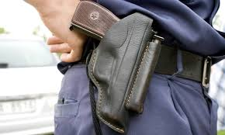
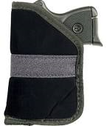
Types of Holsters
Whether a concealed carrier or not, everyone should make themselves aware of various types of holsters and how they are worn. Holster styles change due to carrying a different firearm, the weather, how the carrier is dressed, where they will be carrying, and many other factors.
The basic types of holsters are :
1. Inside-the-waistband – holster attaches to pants and belt on the inside, nearest to the body.
2. Outside-the-Waistband - considered “open carry” if not covered by a shirt or jacket to conceal it.
3. Pocket – small holster that holds the gun and is placed completely into a pants pocket.
4. Shoulder – another option that can be used for open or concealed carry if it is covered by a coat or shirt.
5. Gun-Purse – type of bag that is made with a built-in holster and usually a quick-access point.
Remember: No matter what style of holster is used, the firearm should never be un-holstered on campus
1 2 3 4 5

Slide 11
Where to Find More Information
Complete U.T. Tyler Handguns on Campus Policy: http://catalogs.uttyler.edu/en/UTTyler/HOP/Series-200-General-Policies-and-Procedures/2-10-1-Concealed-Handguns-on-Campus
Facts about campus carry: http://www.uttyler.edu/about/campus-carry/facts.php
House Bill 11: http://www.legis.state.tx.us/BillLookup/History.aspx?LegSess=84R&Bill=SB11
Campus Carry FAQ: http://www.uttyler.edu/about/campus-carry/facts.php
Texas Department of Public Safety: https://www.txdps.state.tx.us/
E Mail Questions To:
UT Tyler Police Department: police@uttyler.edu or call 903-566-7302
UT Tyler Emergency Management Coordinator , Randal Duke, rduke@uttyler.edu
UT Tyler Chief of Police Mike Medders , mmedders@uttyler.edu

