Slide 1
The Office of the Registrar One-Stop Service Center, University Contact Center, & Graduation Help Desk
Jessica Collins

Slide 2
Who are we?
The Office of the Registrar
The One-Stop Service Center & University Contact Center
Service Specialists- prospective students, current students, alumni, & community
Contact Specialists- prospective students, current students, alumni, & community
Record Specialists- staff, advisors, faculty, & professional organizations
Cashiers- campus and community
The Graduation Help Desk
Evaluating and removing barriers to graduation, whether it be a case-by-case basis or a systemic process. Advocating timely graduation and campus culture of student success.
TSI Programming
Academic Scheduling
Athletic Certification
Commencement

Slide 3
One-Stop Service Center
Benchmark One-Stop Service Center and customer service model for Texas
Frequently toured by other universities and colleges looking to implement a One-Stop!
One-Stop Service Center Convenience:
A student at any other university will need to visit an average of 7 different offices and wait in 7 different lines all over campus to start out their semester
Let us help you save time and skip frustration!

Slide 4
Covered at the One-Stop Service Center
Enrollment
Scholarships
Admissions
Student Records
Degree Audits
Transcript Evaluations
GPA and Excessive Hours Calculations
Financial Aid
Exemptions and Waivers
Cashiering
Application of Veteran Benefits
Student Account Troubleshooting
Graduation Help Desk Program: Analyzing Barriers to Graduation
General inquiries, guidance, and assistance
Anything else confusing, unknown, and troubling (try us…)

Slide 5
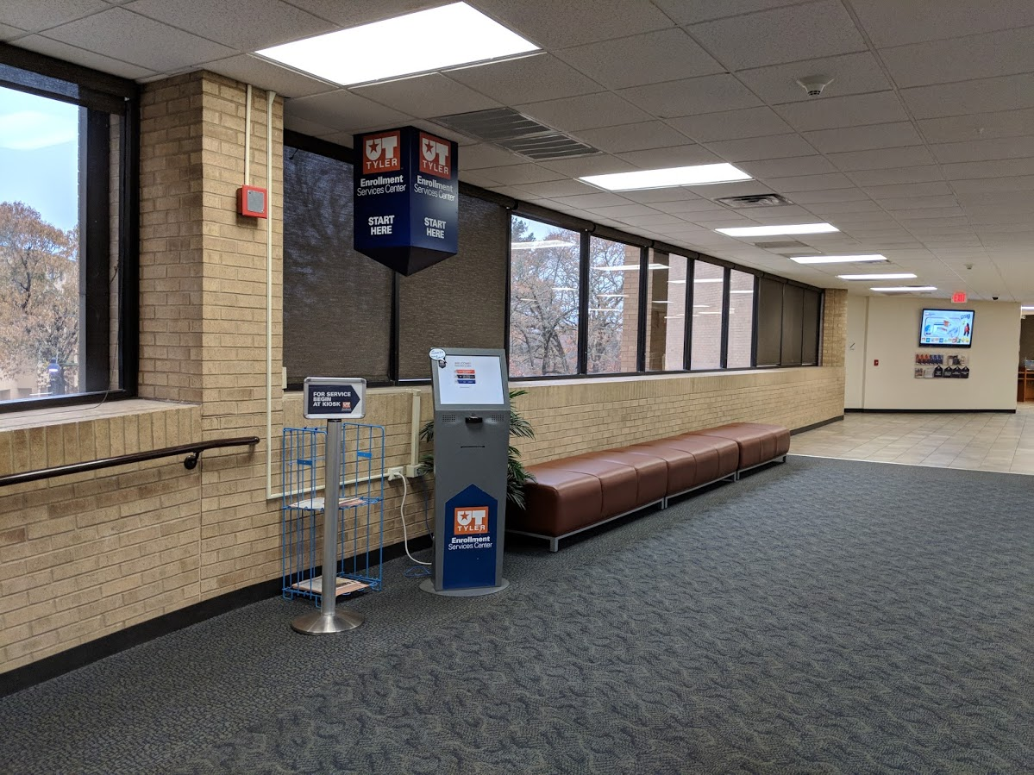
Check-In at the Kiosks
Always Bring Student ID Card for Assistance

Slide 6
Student Information Privacy and Other Things You Should Know to Help Make Your Life Easier

Slide 7
The Family Educational Rights and Privacy Act (FERPA)
FERPA is an act passed by Congress (1974) to protect student records.
The Office of the Registrar website has in-depth information. ESC also has quick guide.
Per the Texas Public Information Act, the University may release Directory Information to any party that requests the information.

Slide 8
Directory Information
Name, address, phone number
Major
Dates of attendance
Previous institution
Classification
Degrees and awards received
Date of graduation
Campus email address
Photographs
Participation in recognized activities & sports
Weight & height (athletes only)
Enrollment status

Slide 9
Patriot Email Address
yourname@patriots.uttyler.edu
Student information will be given to the student in person with photo ID or via Patriot email.
Check regularly!! All official University communication goes to this address.
Please never share this password with anyone!

Slide 10
TALK TO YOUR ADVISOR!

Slide 11
Student Center
The Student Center area of myUTTyler account is one of the most important things to learn how to use while you are a student at UT Tyler. From your Student Center you can:
Enroll in courses
View grades and unofficial transcripts
Apply for graduation
View and update address, email, and phone data
View and accept/decline your Financial Aid awards
Check holds and to-do lists
View billing and financial information
View 1098-T forms

Slide 12
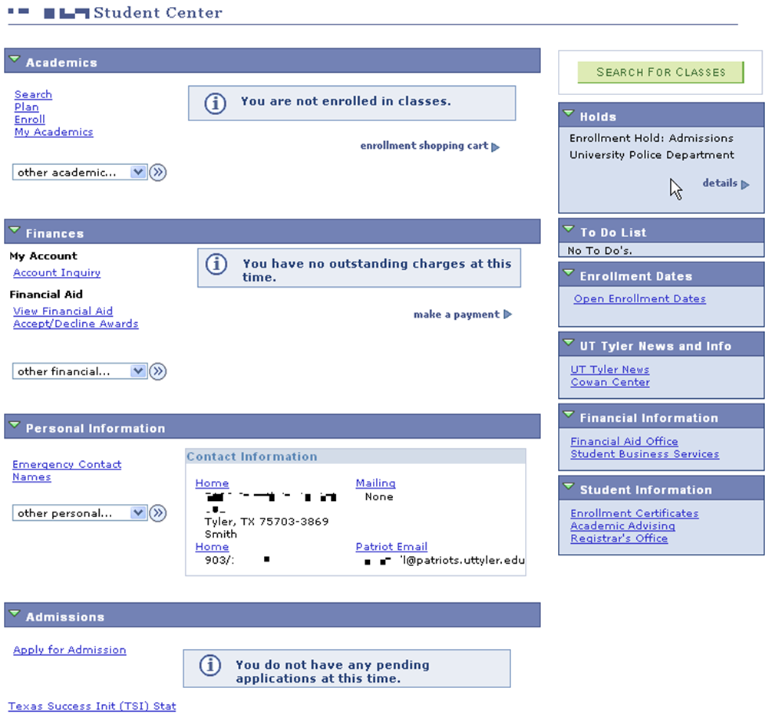
Student Center Example

Slide 13
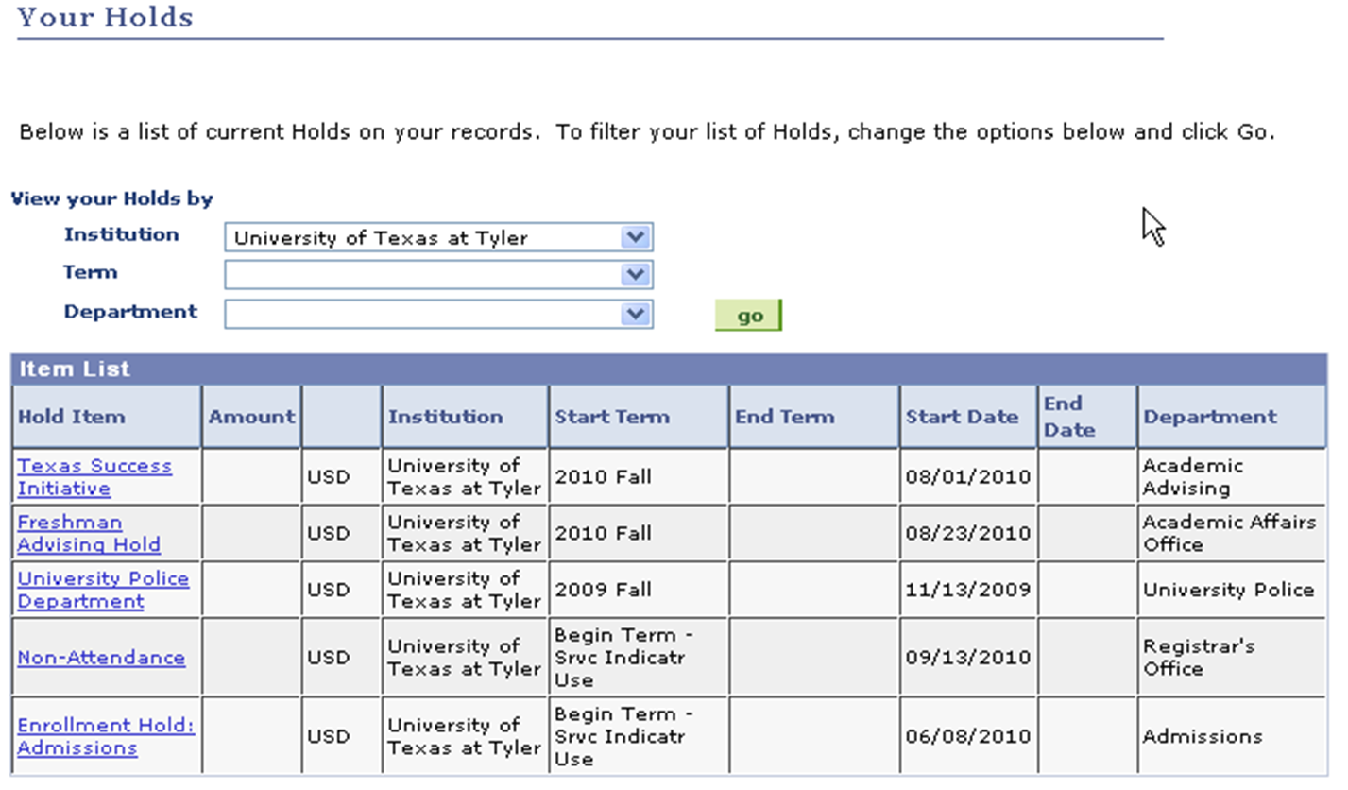
Student Center Example: Holds

Slide 14
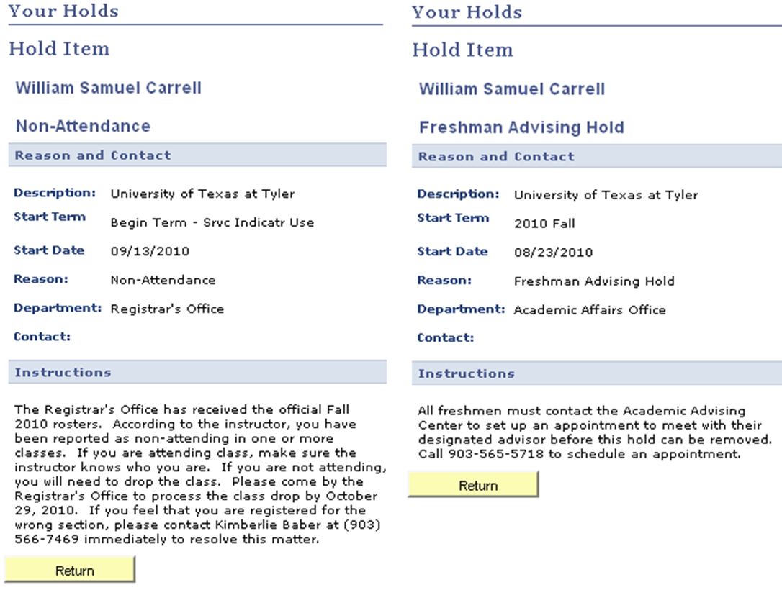
Student Center Example: Holds

Slide 15
Where and how can we be reached?
Visit
One-Stop Services Center (OSC)
Phone
903-566-7180
Email
All Subject Cross-Trained Shared Inbox- Enroll@uttyler.edu
Monitored and answered by every staff member all day long
All inquiries are acceptable regardless of subject matter
Live Chat
https://uttyler.askadmissions.net/groupchat/LandingPage.aspx

