Slide 1

Appendix
Notes:
The following section has sample questions that you may encounter on the GRE as well as their correct answer.

Slide 2
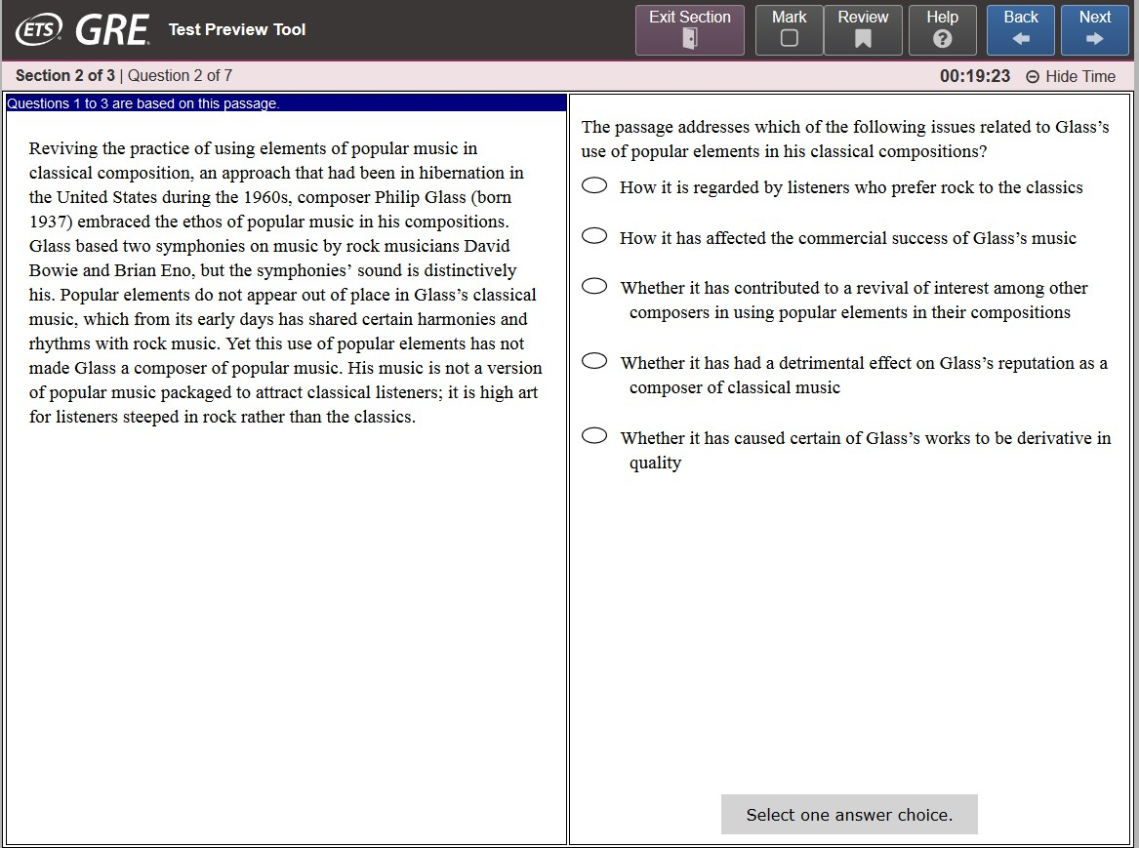
Verbal Reasoning: Reading Comprehension
Multiple Choice — Select One Answer Choice

Slide 3
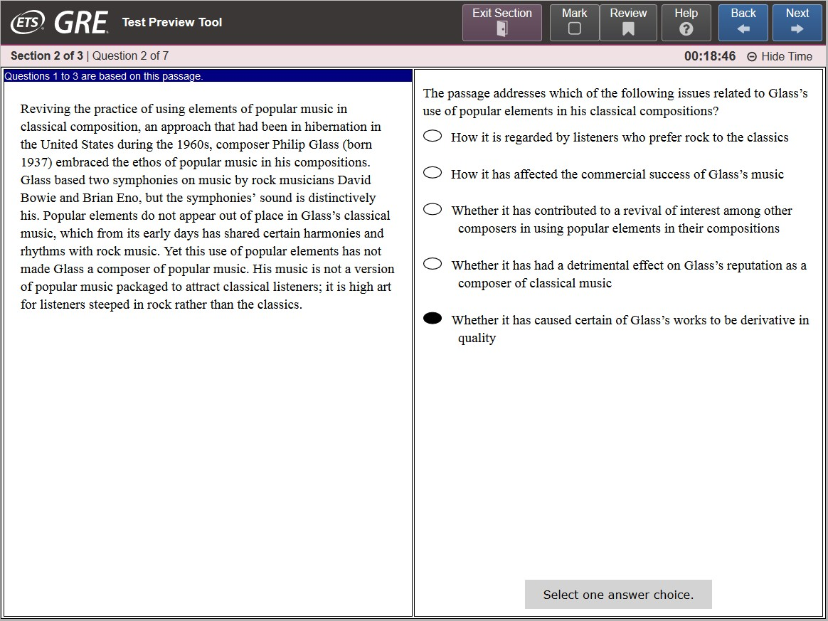
Verbal Reasoning: Reading Comprehension
Multiple Choice — Select One Answer Choice (continued)

Slide 4
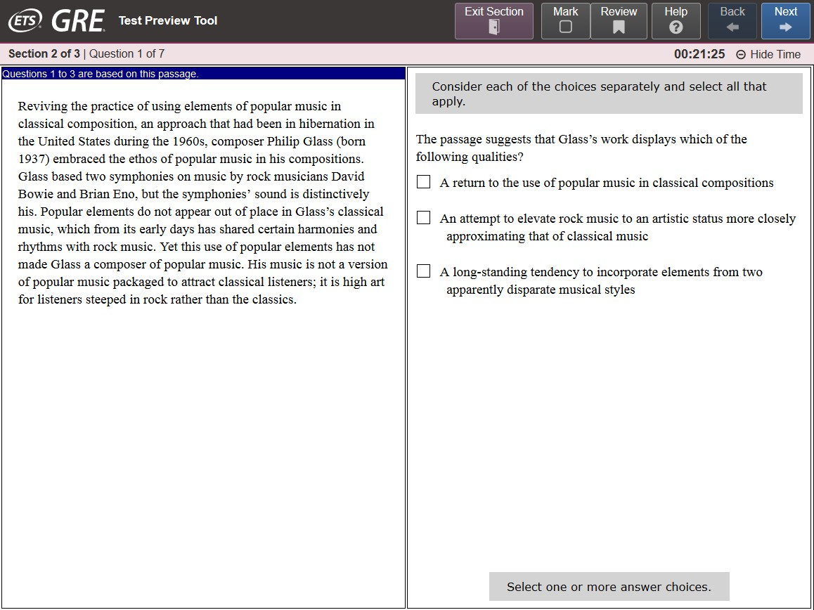
Verbal Reasoning: Reading Comprehension
Multiple Choice — Select One or More Answer Choices

Slide 5
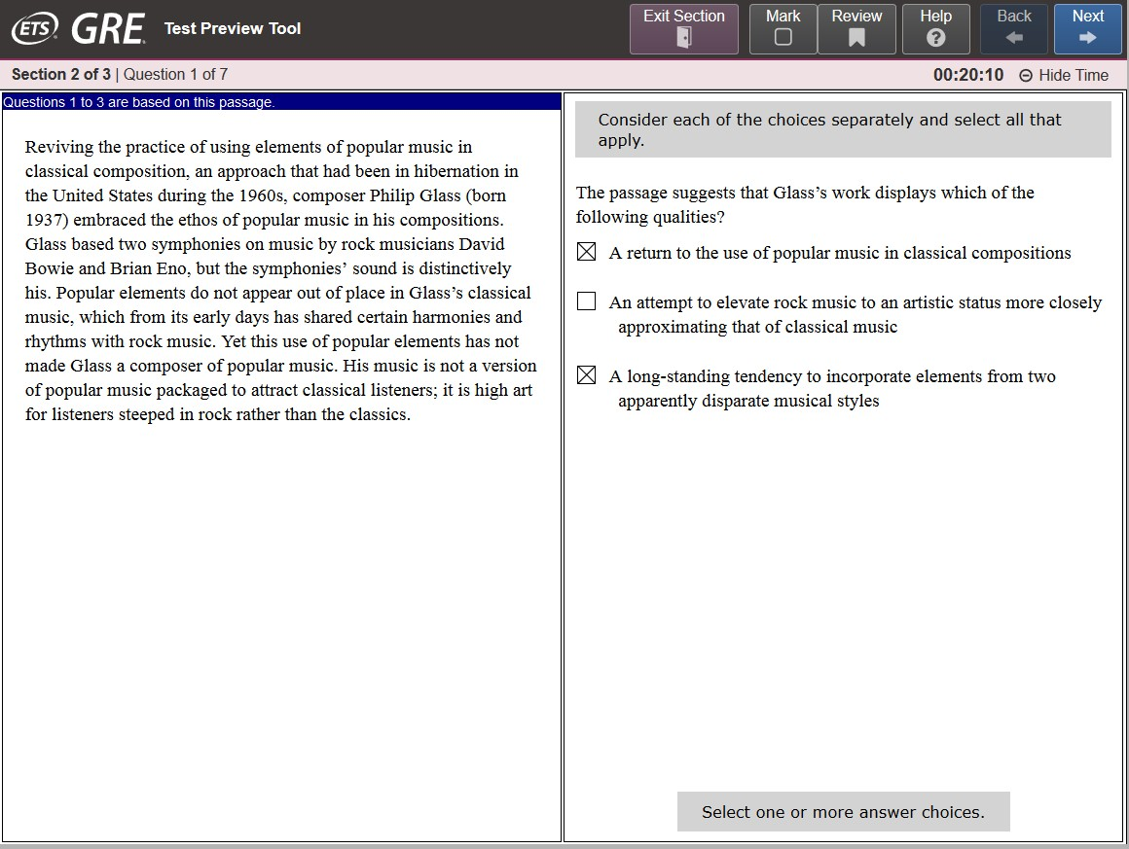
Verbal Reasoning: Reading Comprehension
Multiple Choice — Select One or More Answer Choices
(continued)

Slide 6
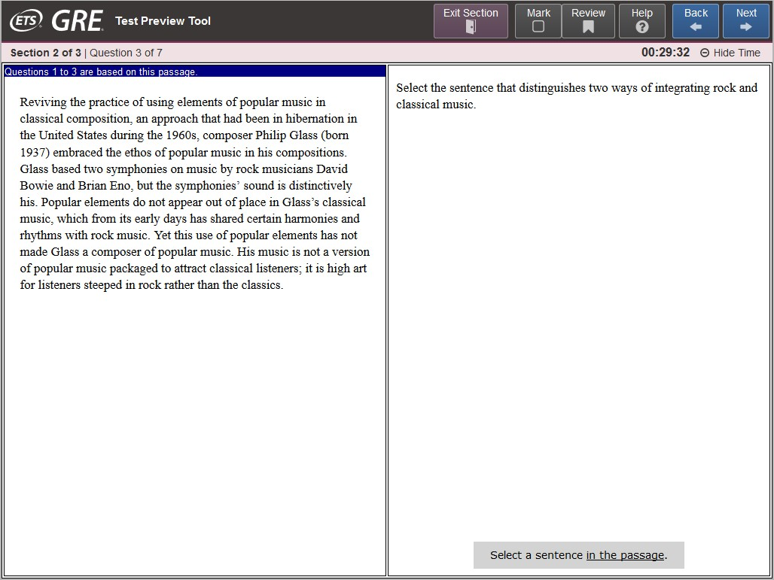
Verbal Reasoning: Reading Comprehension
Select in Passage

Slide 7
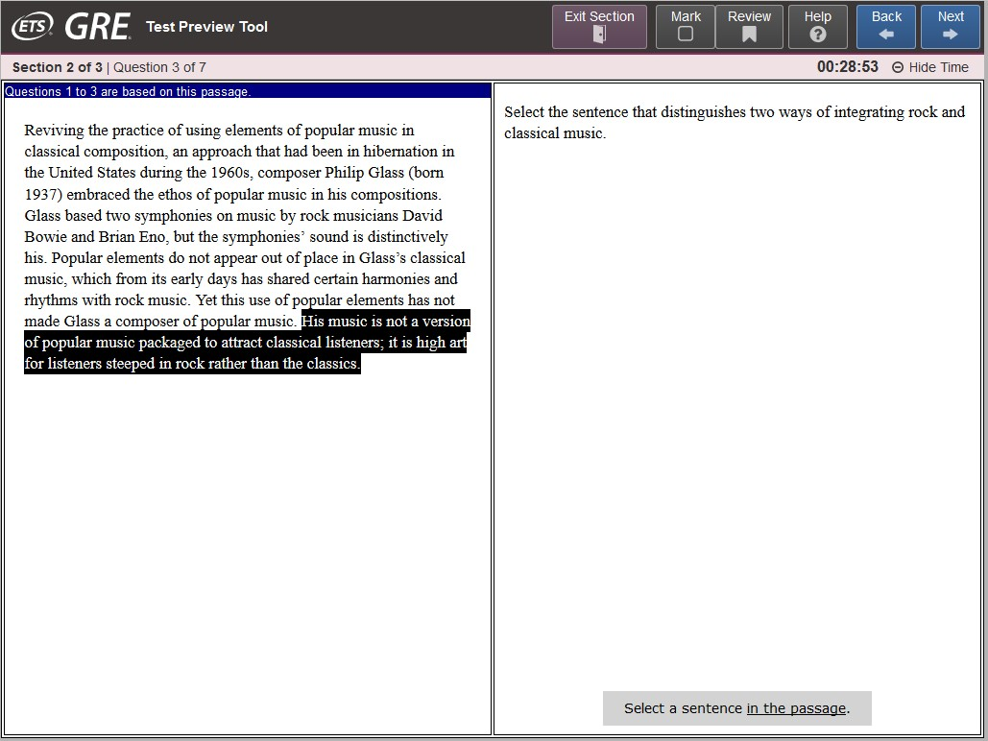
Verbal Reasoning: Reading Comprehension
Select in Passage (continued)

Slide 8
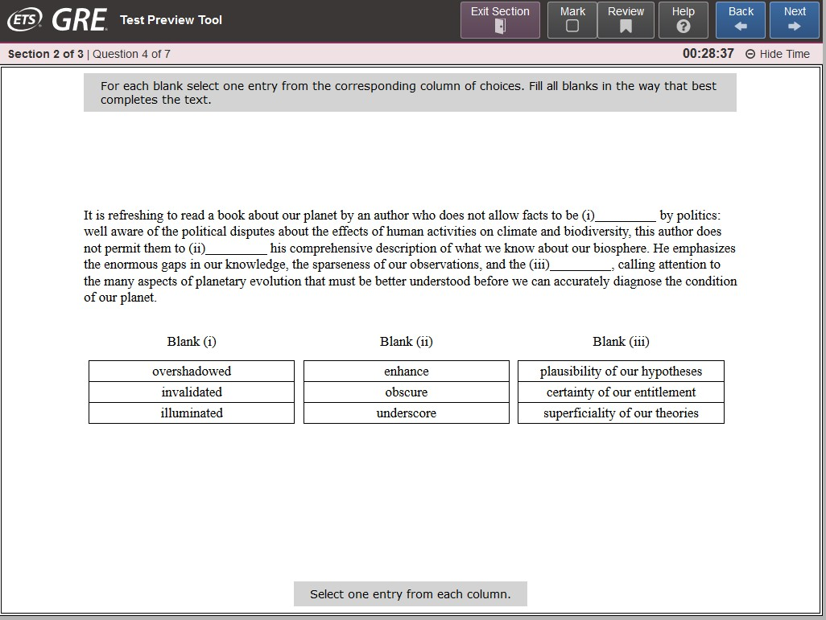
Verbal Reasoning: Text Completion Question

Slide 9
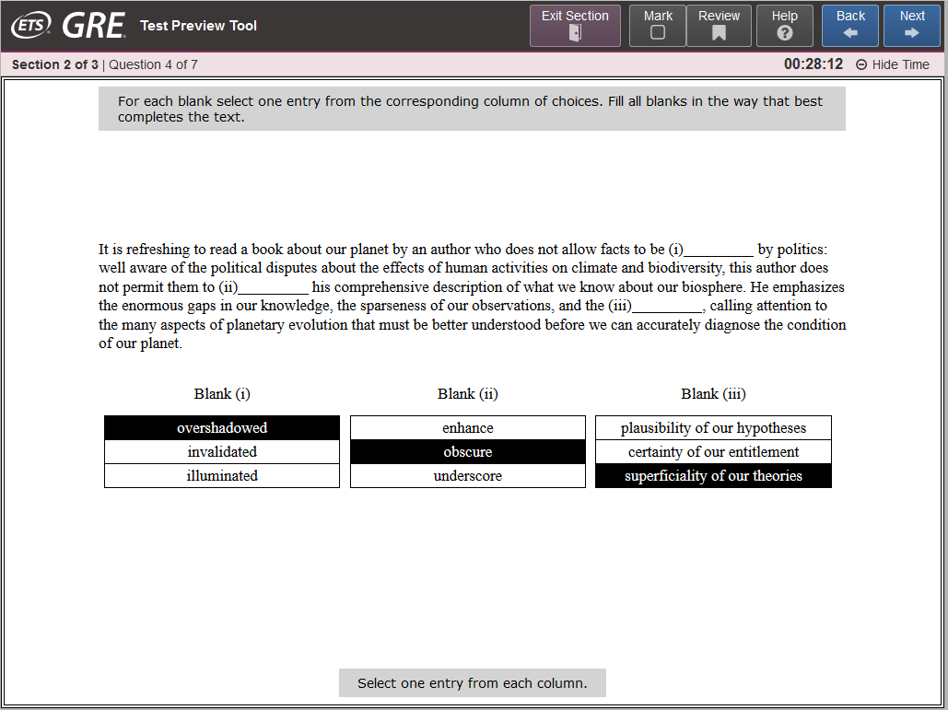
Verbal Reasoning: Text Completion Question
(continued)

Slide 10
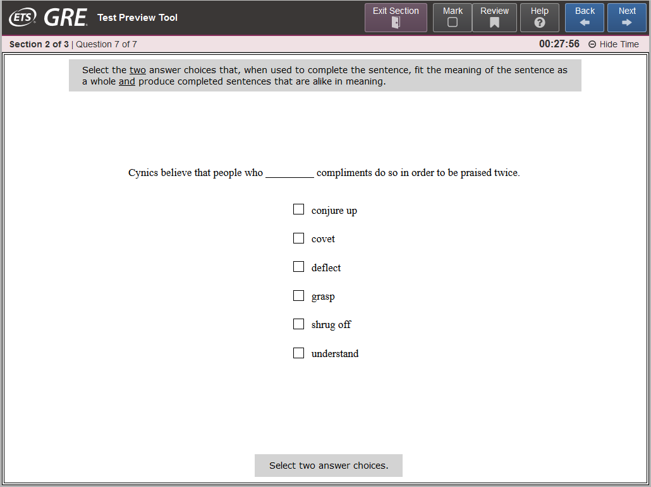
Verbal Reasoning: Sentence Equivalence Question

Slide 11
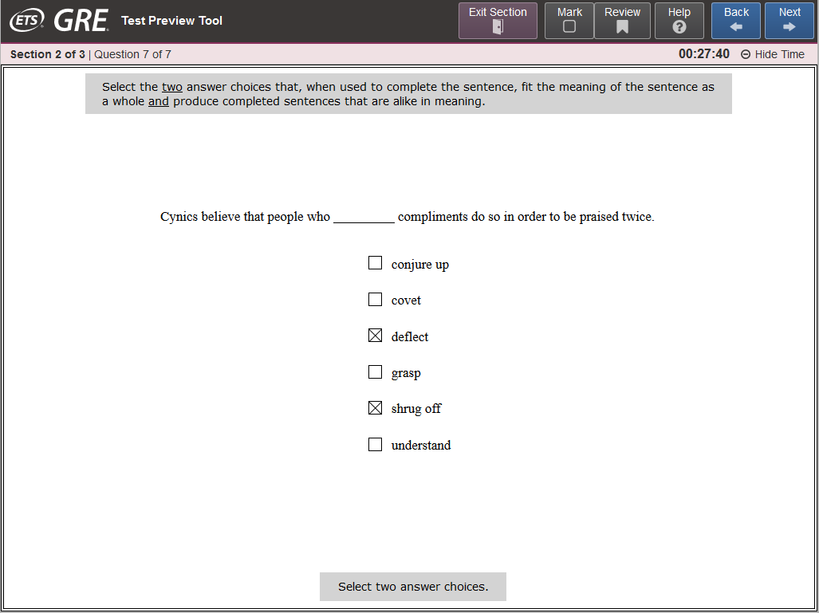
Verbal Reasoning: Sentence Equivalence Question (continued)

Slide 12
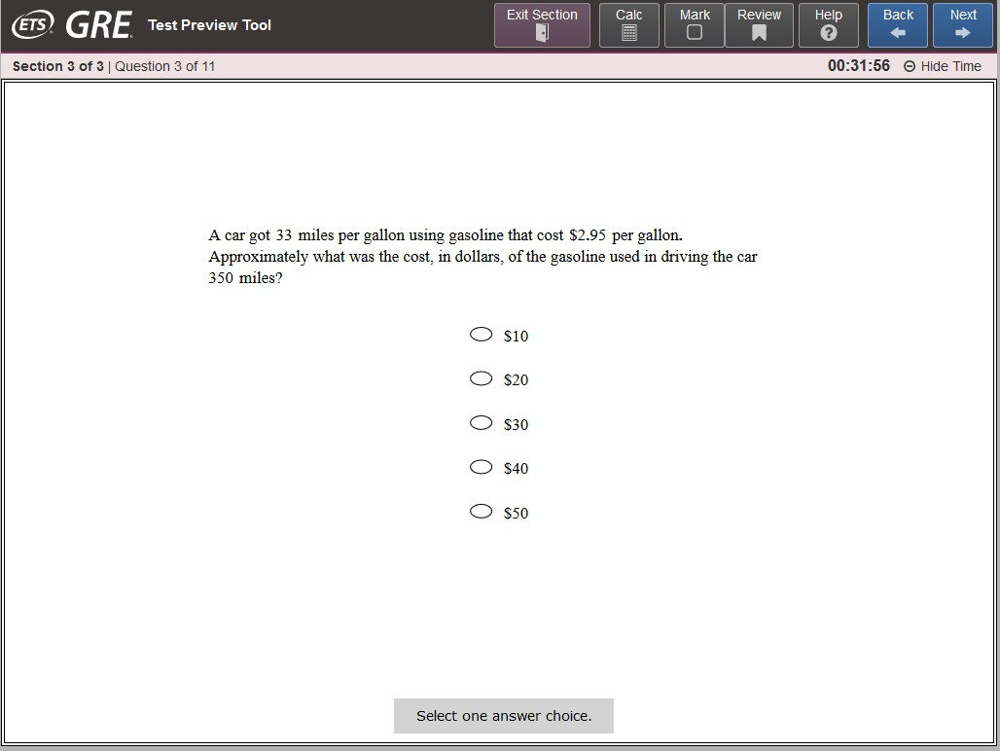
Quantitative Reasoning: Multiple Choice, Select One Answer Choice

Slide 13
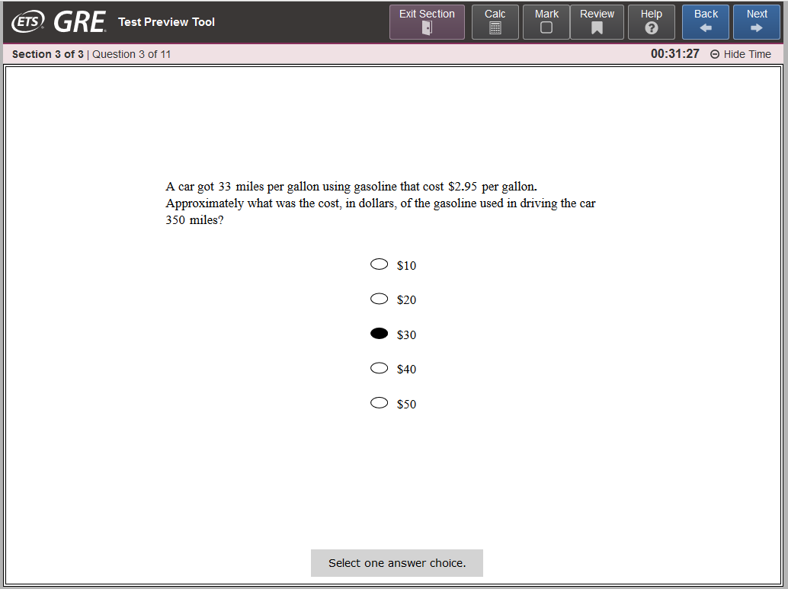
Quantitative Reasoning: Multiple Choice, Select One Answer Choice (continued)

Slide 14
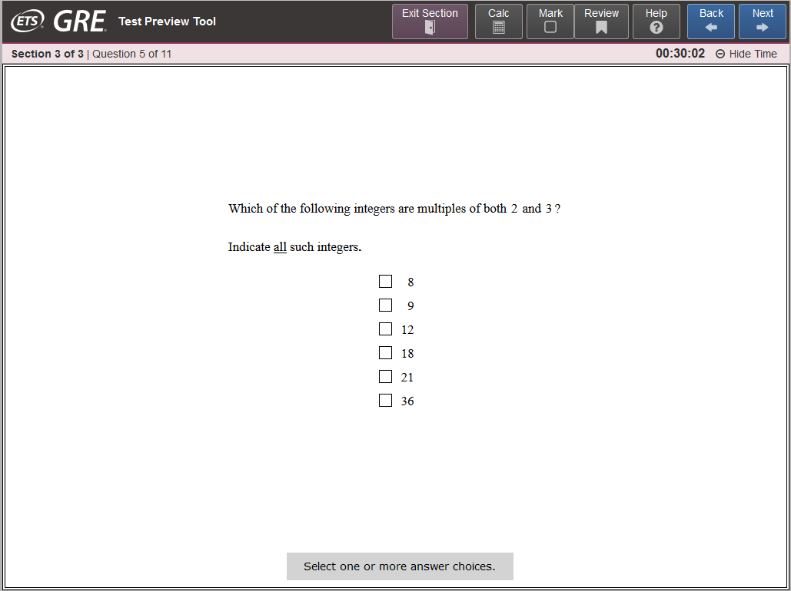
Quantitative Reasoning: Multiple Choice, Select One or More Answer Choices

Slide 15

Quantitative Reasoning: Multiple Choice, Select One or More Answer Choices (continued)

Slide 16
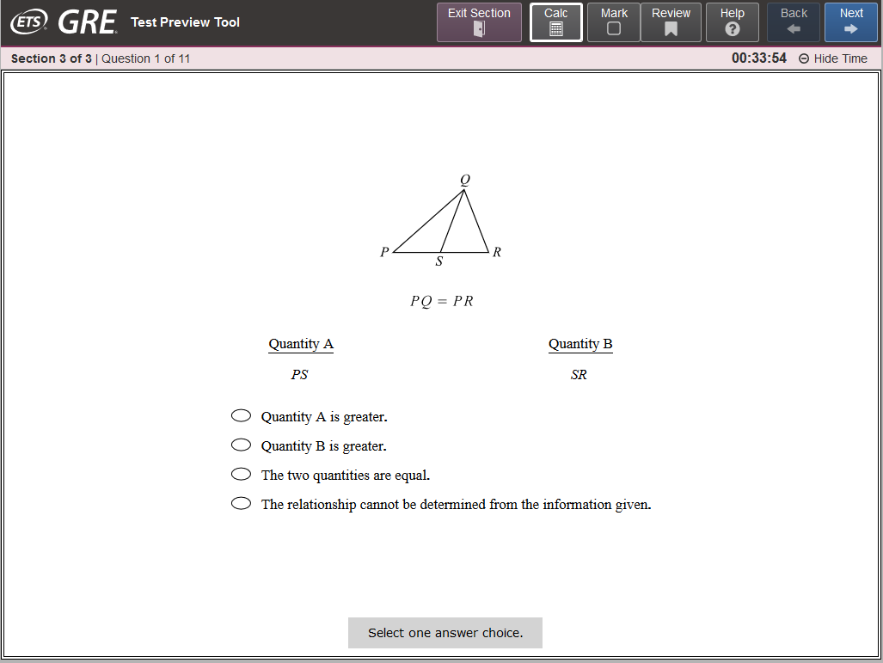
Quantitative Reasoning: Quantitative Comparison Question

Slide 17
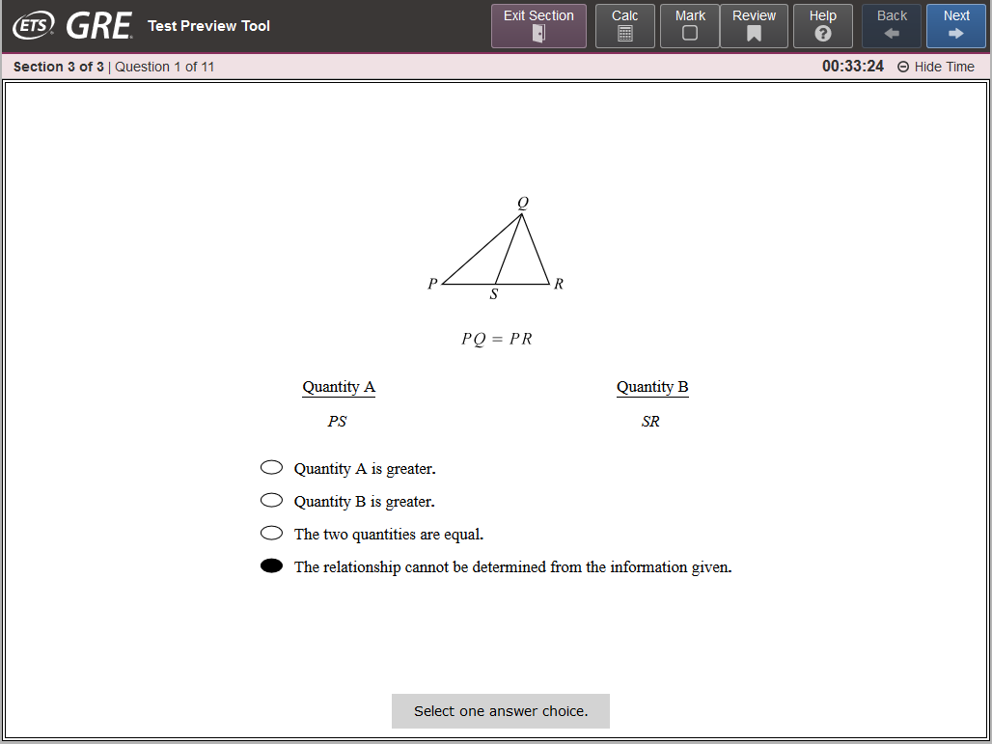
Quantitative Reasoning: Quantitative Comparison Question (continued)

Slide 18
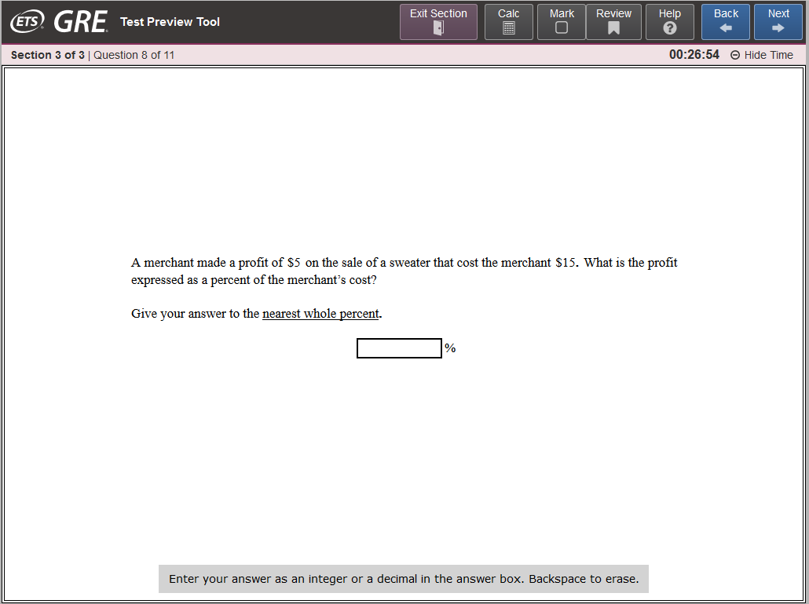
Quantitative Reasoning: Numeric Entry Question

Slide 19
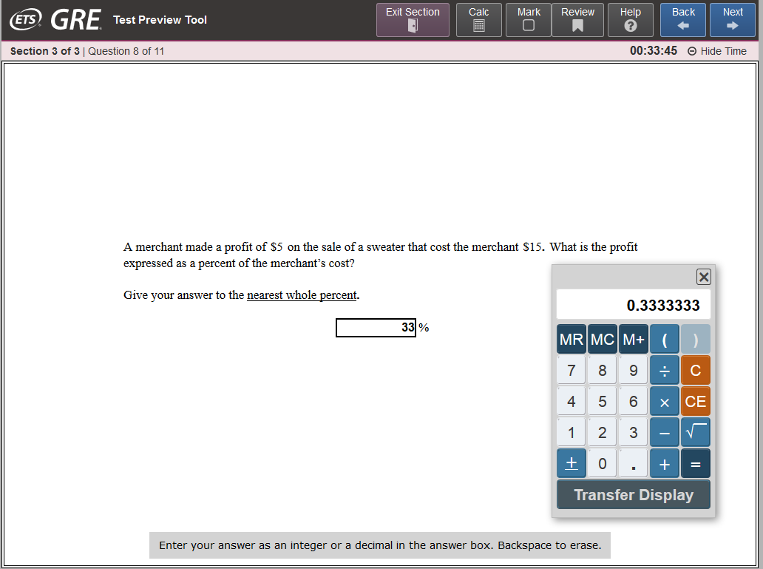
Quantitative Reasoning:
Numeric Entry Question (continued)

Slide 20
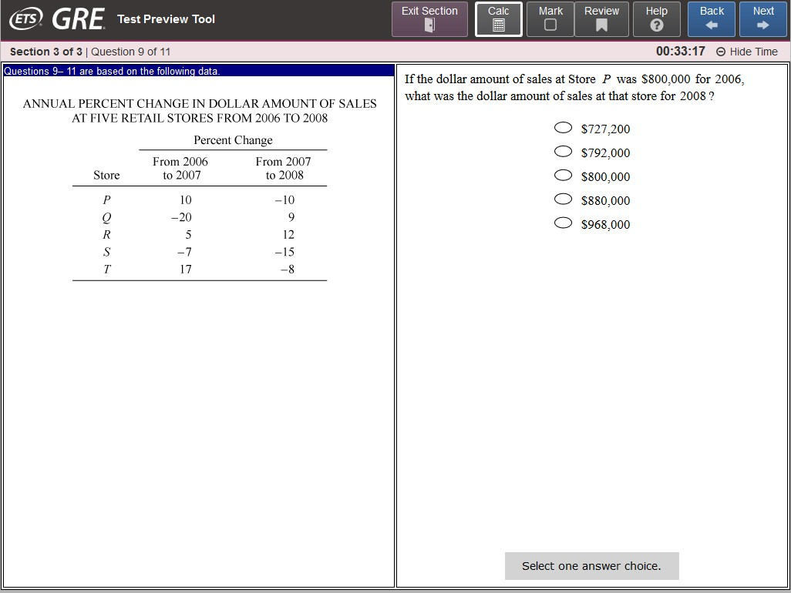
Quantitative Reasoning: Data Interpretation Question

Slide 21
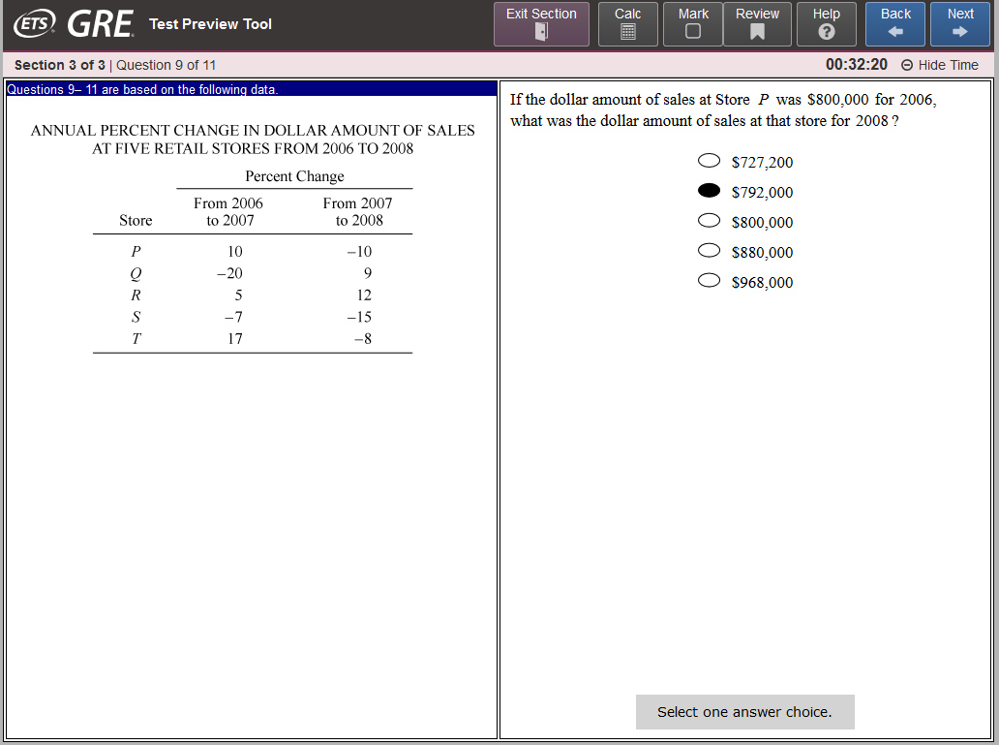
Quantitative Reasoning:
Data Interpretation Question (continued)

Slide 22
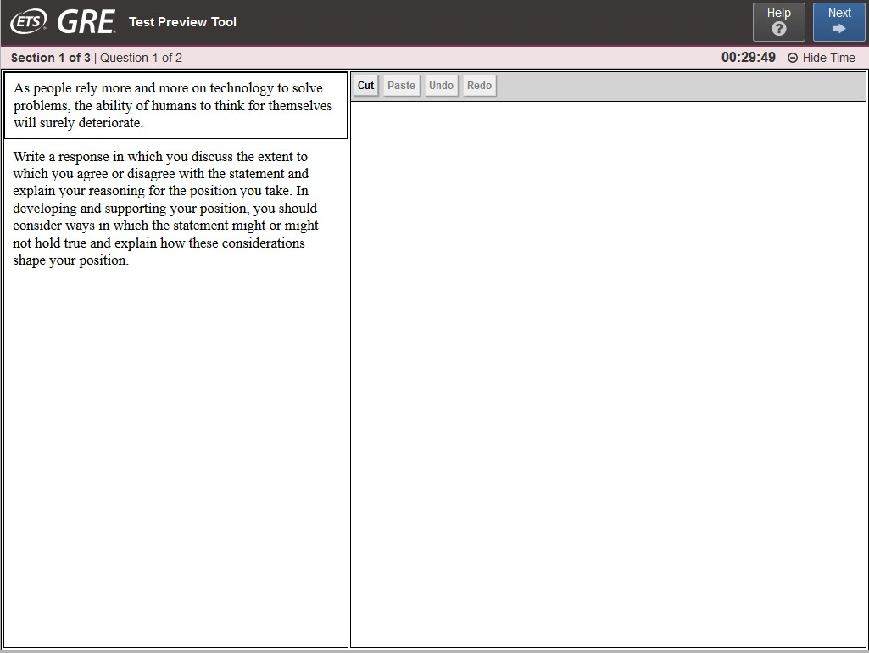
Analytical Writing: Analyze an Issue Task

Slide 23
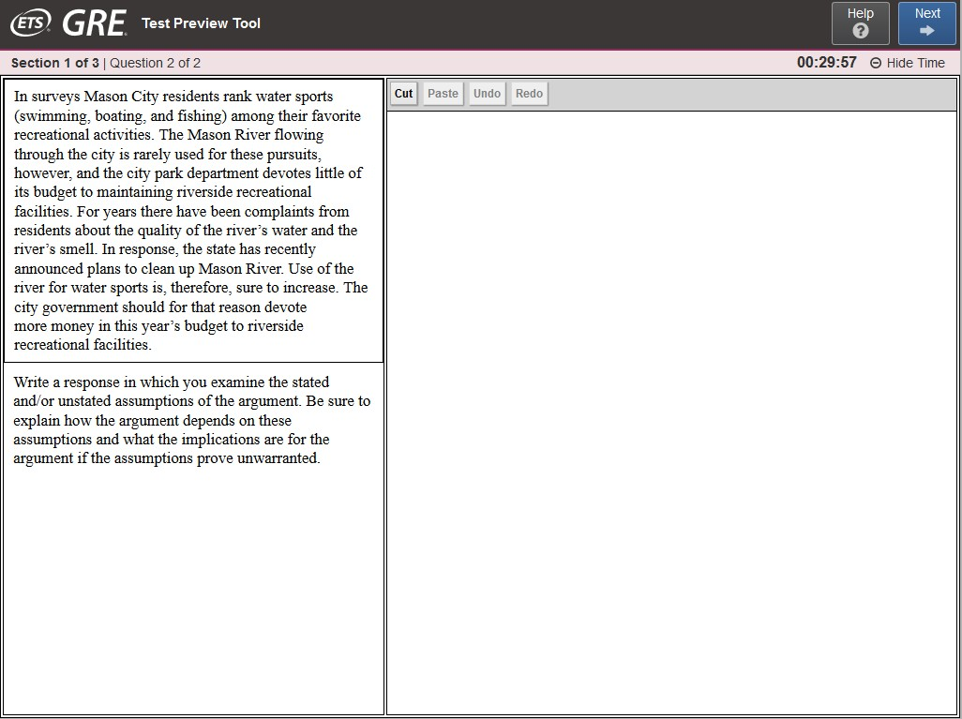
Analytical Writing: Analyze an Argument Task
Copyright © 2018 by Educational Testing Service. All rights reserved. ETS, the ETS logo, MEASURING THE POWER OF LEARNING, GRE, SCORESELECT, POWERPREP and POWERPREP PLUS are registered trademarks of Educational Testing Service (ETS) in the United States and other countries. SCOREITNOW! is a trademark of ETS. All other trademarks are property of their respective owners. 39557
80

