Slide 1
Schedule of Classes Training
Spring 2023
{ Office of the University Registrar }

Slide 2
Content
Introduction to the Schedule of Classes
Scheduling Your First Class in PeopleSoft
Maintaining Classes Once They are Created
Astra training is on CANVAS

Slide 3
1. Introduction 2. Your First Class 3. Maintaining Classes 4. Room Selection
Overview | Reminders | Scheduling Timeline | Terminology
Introduction to the Schedule of Classes
Overview | Reminders | Scheduling Timeline | Terminology

Slide 4
1. Introduction 2. Your First Class 3. Maintaining Classes 4. Room Selection
{Overview} | Reminders | Scheduling Timeline | Terminology
Overview
At UT Tyler, updating the Schedule of Classes each semester is a decentralized effort, with designated departmental staff working with the Registrar’s Office in the creation and maintenance of course sections.
We start working on the Spring and Summer schedule of classes in September, and we start working on Fall in February. Students begin registration for Spring courses at the beginning of November, Summer courses at the beginning of February, and Fall courses at the beginning of April.
AcademicScheduling@uttyler.edu sends out email communications notifying the departments of all the pertinent scheduling periods and deadlines.
This Schedule of Classes training provides step by step instructions on how to create and maintain scheduled classes in PeopleSoft.
Please do not hesitate to contact AcademicScheduling@uttyler.edu should you have questions about the Schedule of Classes.

Slide 5
1. Introduction 2. Your First Class 3. Maintaining Classes 4. Room Selection
Overview | {Reminders} | Scheduling Timeline | Terminology
Reminders
Large 100+ Capacity Courses: These will need to be the first courses you enter in PeopleSoft, as they are then scheduled into rooms in Astra by Maggie Sorrell in the Registrar’s Office. You will then follow that with your 50-99 capacity courses. Courses with enrollment set at 50-99 will still be scheduled into rooms in Astra by Departmental Admins.
Requested Room Capacity Reminder: Please enter a true requested number rather than leaving this at the default.
Instructions are included on how to apply Class Attributes for courses that may need designations such as Hybrid, Service-Learning Designation, BAAS, College for UNIV sections, or Supplemental Instruction.
Changing a section number in PeopleSoft does NOT change the number in Canvas. Contact Scott Dillingham to update section numbers in Canvas so that students can still access the course

Slide 6
1. Introduction 2. Your First Class 3. Maintaining Classes 4. Room Selection
Overview | {Reminders} | Scheduling Timeline | Terminology
Reminders
Request for Scheduling Exception Reminder: Classes must meet during standard meeting pattern times. Requests to schedule sections during non-standard meeting pattern times must be approved by the Department Chair, Dean, and Academic Affairs (the Provost). This process will be done through a chain of emails.
Instruction Mode: For State Reporting purposes, choose 1 Face-to-Face, 2 for Full Distance Learning, 4 for Zoom, or 6 for Hybrid instead of leaving the default of P (In-Person). Instruction mode should never be left as "P."
Load Factor field: Instructions on the Workload tab including multiple instructors for Meeting Patterns and information on percentages for Hybrids will be provided.
UNIV Prefix: Please remember to change the Academic Organization to your department when using the UNIV Prefix and add the College Course Attribute.
New Common Meeting Time: Started in Spring 2018, the Provost declared Thursdays from 12:30PM to 1:50PM to be a “Common Meeting Time,” during which time no classes should be scheduled. Make sure that when you are scheduling a section that it does not fall within this time.

Slide 7
1. Introduction 2. Your First Class 3. Maintaining Classes 4. Room Selection
Overview | Reminders | {Scheduling Timeline} | Terminology
Production Schedule
Production Stage | Due Date
Departments Attend Training for PeopleSoft | Sept 13-14
Departments Enter Courses for Spring and Summer in PeopleSoft | Sept 15 – Sep 23
Data Entry Error Review and Cleanup in PeopleSoft | Sept 26 – Sept 30
Spring Data Loaded from PeopleSoft to Astra | Sept 30
Large Capacity Classroom Scheduling | Oct 3 - 7
Astra *Restricted Scheduling – Spring Only | Oct 10 - 14
Astra Opens for Scheduling* – Spring Only | Oct 17 - 21
Departments Scheduling in Astra Closed for Spring Classes | Oct 21 @ 5:00 PM CST
­Deadline for Changes to Existing Spring Classes in PeopleSoft | Oct 21
Spring SOC available via Class Search to students and staff in PeopleSoft | Oct 25
Registration for Spring Opens | Nov 1
Departments Finalize Summer Schedule in PeopleSoft | Completed by Dec 16 @ 5:00 PM CST
Data Entry Error Review and Cleanup | Jan 2 - 6
Summer Data Loaded from PeopleSoft to Astra | Evening Jan 6
Astra Region Restricted Scheduling | Jan 9 - 13
Astra Opens for Scheduling – Summer | Jan 16 - 20
Departments Scheduling in Astra Closed for Summer Classes | Jan 20 @ 8:00 AM CST
Deadline for Changes to Existing Summer Classes in PeopleSoft | Jan 20
Summer SOC available via Class Search to students and staff in PeopleSoft | Jan 25
Registration for Summer Opens | Feb 1

Slide 8
1. Introduction 2. Your First Class 3. Maintaining Classes 4. Room Selection
Overview | Reminders | Scheduling Timeline | {Terminology}
Terminology Used at UT Tyler
Associated Class - The Associated Class field on the Basic Data tab of Maintain Schedule of Classes is primarily used when scheduling courses with embedded labs. Assigning matching Associated Class numbers to lectures and labs will link the sections together so that when students are enrolling in the lecture section, they will only be able to choose from the embedded labs that have been associated with that lecture section.
Class Attributes – Course attributes are used primarily for institutional research and reporting purposes.
Class Status - Displays whether the course is Active, Stop Further Enrollment, Tentative, or Cancelled. The system populates this field to Active by default. You can override the status to indicate Stop Further Enrollment, or Tentative.
Component - Each course has at least one component. For instance, a lecture course will have Lecture as its component. Courses may have an associated lab as an additional component of the same course. Components do not have their own course ID. They are tied to the original course. Other component examples are: Clinical, Practicum, etc.

Slide 9
1. Introduction 2. Your First Class 3. Maintaining Classes 4. Room Selection
Overview | Reminders | Scheduling Timeline | {Terminology}
Terminology Used at UT Tyler
Enrollment Capacity – The maximum number of students allowed to enroll in a section.
Requested Room Capacity – The number of student stations required (Both Enrollment Capacity and Requested Room Capacity will be the same).
Session - This field refers to the Academic Session for the course being scheduled. Sessions are subsections of a Term (Fall, Spring, Summer.)
Standard Meeting Pattern – Fall and Spring have Standard Meeting Pattern times as designated by Academic Affairs. Please see the Standard Meeting Patterns for 3 Credit Hour Courses chart further on in this documentation, in the Meetings section of Scheduling Your First Class in PeopleSoft. Courses should follow the Standard Meeting Pattern grid, and if there is an exception the Scheduling Exemption process must be submitted to AcademicScheduling@uttyler.edu with all appropriate approvals.
Term – There are three terms at UT Tyler: Spring, Summer, and Fall. PeopleSoft has a 4 number code for each term. The first number represents the current millennium. The middle two numbers represent the year and the last number indicates the term - 2 for Spring, 5 for Summer, and 8 for Fall. For example, the Fall 2016 term would be 2168; the Spring 2019 term would be 2192; and the Summer 2021 term would be 2215.

Slide 10
1. Introduction 2. Your First Class 3. Maintaining Classes 4. Room Selection
Schedule New Course | Basic Data | Meetings | Enrollment Cntrl | Reserve Cap | Notes
Scheduling Your First Class in PeopleSoft
Schedule New Course | Basic Data | Meetings | Enrollment Cntrl | Reserve Cap | Notes

Slide 11
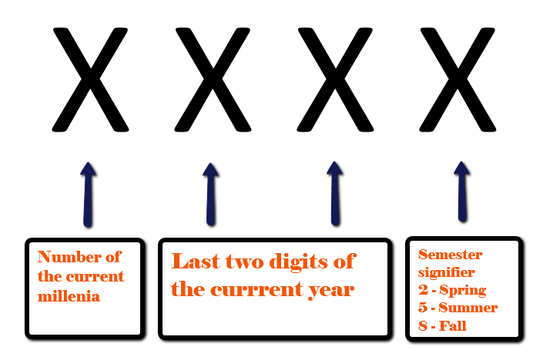
1. Introduction 2. Your First Class 3. Maintaining Classes 4. Room Selection
{Schedule New Course} | Basic Data | Meetings | Enrollment Cntrl | Reserve Cap | Notes
Term: Use this field to enter in the term you are scheduling for; see the example below:

Slide 12
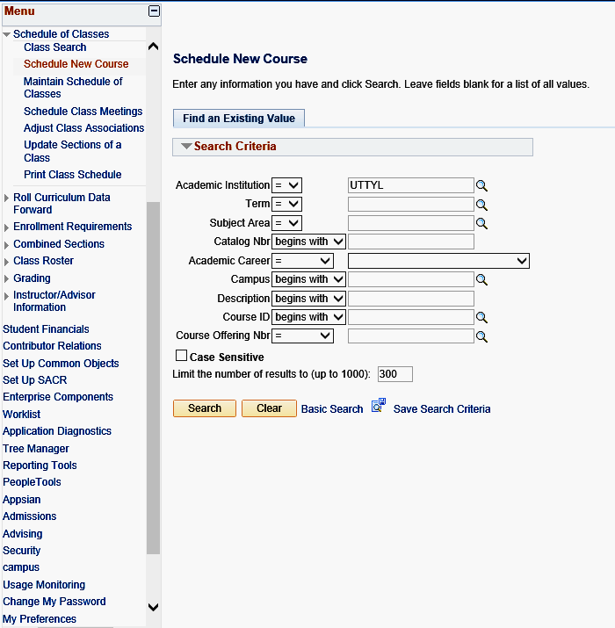
1. Introduction 2. Your First Class 3. Maintaining Classes 4. Room Selection
{Schedule New Course} | Basic Data | Meetings | Enrollment Cntrl | Reserve Cap | Notes
Scheduling a New Course
Navigation
To begin, navigate to Curriculum Management>Schedule of Classes>Schedule New Course.
The Academic Institution field should default to UTTYL. If it does not, enter UTTYL.
Input the correct term code in the Term field or click the magnifying glass icon for the value.
Input information in other fields on the search page to locate the required class(es) such as Subject Area (ex. POLS, EDUC) or Academic Career (ex. UGRD, GRAD, PHR).
When finished, click on the Search button.
Your search can be as specific or as general as needed. Be aware that only the first 300 results will be returned in the search unless you increase the number in the “Limit the number of results” field just under the Case Sensitive checkbox. For most purposes, a search producing a smaller population is more useful.
Pro Tip:

Slide 13
1. Introduction 2. Your First Class 3. Maintaining Classes 4. Room Selection
{Schedule New Course} | Basic Data | Meetings | Enrollment Cntrl | Reserve Cap | Notes
Scheduling a New Course
Search Results
Click the link in Search Results that describes the class to be added. This action opens the Basic Data page in the Schedule New Course component.
Make sure to use only Course Offering 1.
NOTE: All regular courses should be scheduled using Course Offering Number 1 exclusively. Use of Course Offering Number 2 is restricted to special programs (Academic Partnerships) sections and is limited to use by Enrollment Management personnel only.
Please reach out AcademicScheduling@uttyler.edu if your area needs a special program course scheduled using offering number 2.
Pro Tip:
Be sure to check the Course Offering Number if more than one search result shows. Use only Course Offering Number 1 for Schedule of Classes

Slide 14
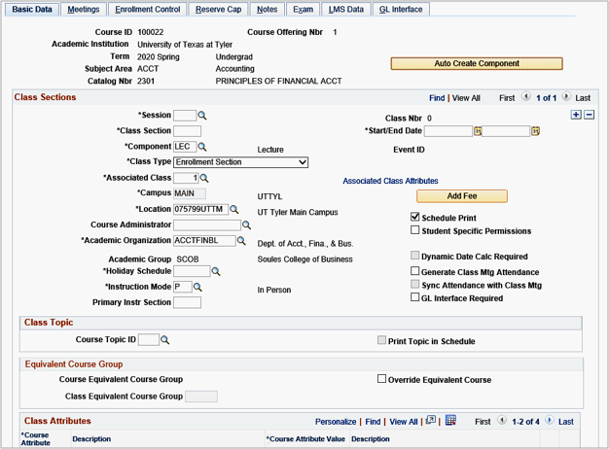
1. Introduction 2. Your First Class 3. Maintaining Classes 4. Room Selection
Schedule New Course | {Basic Data} | Meetings | Enrollment Cntrl | Reserve Cap | Notes
Basic Data Tab
Overview of Screen Layout
The Tabs will appear at the top of the page with the Basic Data Tab appearing first. Under the tabs, information from the Course Catalog is brought over and includes the Course ID, Term, Subject, Catalog number, and Title. The Auto Create Component button is also present in yellow. We do not use the Auto Create Component.
Session
Begin by typing in the session value for the section you are scheduling. Click on the magnifying glass icon next to the empty Session field box to see all available session values.
Start/End Date
Once the session code is entered, the Start/End Date fields will automatically populate based on system values. Do not change the dates on the basic data tab. If the class has different dates than what are displayed in the Start/End Date fields, first confirm that you have chosen the correct session.
If you have chosen the correct session, then you will manually enter the custom start and end dates on the Meetings Tab. Please note that all start dates entered on the Meetings Tab must match the start date for the applicable term, and End Dates must occur on or before the end date of the term.
Pro Tip:
Be sure to SAVE often! Once you save, a Class Number will populate.

Slide 15
1. Introduction 2. Your First Class 3. Maintaining Classes 4. Room Selection
Schedule New Course | {Basic Data} | Meetings | Enrollment Cntrl | Reserve Cap | Notes
Basic Data Tab
Class Section
Enter the section number in the Class Section field. Class Section numbering convention is as follows:
TYPE OF COURSE | FALL/SPRING/SUM I | SHORT SUM | LONG SUM | SUM II
TYLER | 001-029 | 301-329 | 501-529 | 401-429
LONGVIEW, NON-ITV | 090-099 | 390-399 | 590-599 | 490-499
PALESTINE, NON-ITV | 070-079 | 370-379 | 570-579 | 470-479
ITV (INCLUDES NET.NET) | 040-049 | 340-349 | 540-549 | 440-449
INTERNET | 060-069 | 360-369 | 560-569 | 460-469
OFF CAMPUS (NOT TAUGHT ON UT PROPERTY) | 030-039 | 330-339 | 530-539 | 430-439
OTHER (WMBA, SPECIAL 1-HOUR COURSES) | 080-089 | 380-389 | 580-589 | 480-489
ACADEMIC PARTNERSHIP (AP)/ GRALT | 701-799 | NA | NA | NA
Component
The Component field typically defaults to what is in the catalog course inventory, for example, LEC. If a course has more than one component, clicking the magnifying glass will show the additional components, such as Lab. To add a zero-credit component, such as an embedded lab, add a new row to the associated class.
Pro Tip:
The numbering convention table is easiest to read if you first determine what Academic Session you are scheduling in and then determine what “type” of course is being scheduled.

Slide 16
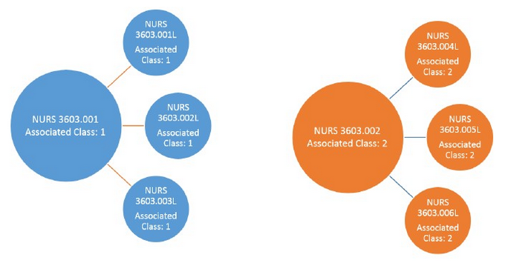
1. Introduction 2. Your First Class 3. Maintaining Classes 4. Room Selection
Schedule New Course | {Basic Data} | Meetings | Enrollment Cntrl | Reserve Cap | Notes
Basic Data Tab
Class Type
Class Type field defaults to Enrollment. The class type of Enrollment indicates which section is the primary section at enrollment time. The class type of Non-Enrollment is used to indicate that the section choice is the student's secondary enrollment option, or that the section is used in auto-enrollment. Within a class, only one component can possess the class type of Enrollment. In the case where you have an embedded lab, be sure the Lecture is set to Enrollment and the Lab is set to non-enroll.
Associated Class
By using Associated Class Numbers, you link class sections that constitute a single course offering. This field is primarily used for embedded labs. Assigning matching Associated Class Numbers to lectures and labs will link the sections together so that when students are enrolling in the lecture section, they will only be able to choose from the embedded labs that have been associated with that lecture section.
For example, if a lecture (NURS 3603.001) and 3 related lab sections (NURS 3603.001L, NURS 3603.002L, NURS 3603.003L) are all assigned the Associated Class number of 1, a student who enrolls In NURS 3603.001 will be only able to choose from NURS 3603.001L, NURS 3603.002L, or NURS 3603.003L. If another lecture (NURS 3603.002) needed to be grouped with a different set of embedded labs (NURS 3603.004L, NURS 3603.005L, NURS 3603.006L), then a different Associated Class Number would be used for those courses (In this example, the Associated Class Number 2 was chosen for these sections).

Slide 17
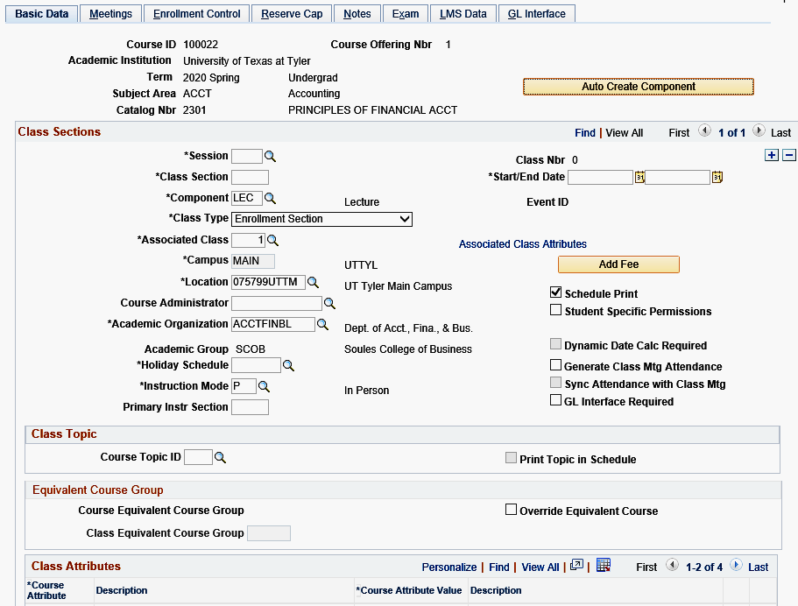
1. Introduction 2. Your First Class 3. Maintaining Classes 4. Room Selection
Schedule New Course | {Basic Data} | Meetings | Enrollment Cntrl | Reserve Cap | Notes
Basic Data Tab
Associated Class (cont’d)
How do you choose which Associated Class Number to use? The Associated Class code should be the same as the lecture section number (leading zeroes will be removed i.e. section 040 becomes Associated Class code 40). For example, NURS 3603.001 would have an Associated Class number of 1, NURS 3603.002 would have an Associated Class number of 2, and NURS 3603.060 would have an Associated Class number of 60. The Lecture should always have the Class Type of Enrollment and the Lab should always be placed on Non-Enroll.
IMPORTANT: Topics classes and classes where the student may enroll in more than one section in the same term MUST have a different Associated Class number for each section in order for the student enrollment process to successfully complete. For example: KINE1201.001 must have an Associated Class number of 1; KINE1201.002 must have an Associated Class number of 2, etc.
The system populates the Campus field by default from the Course Catalog - Offerings page, indicating the campus that offers the course. You cannot revise this default. Campus is different from Location. Campus is where the degree is awarded from, and Location is where the course is being taught.
Campus

Slide 18
1. Introduction 2. Your First Class 3. Maintaining Classes 4. Room Selection
Schedule New Course | {Basic Data} | Meetings | Enrollment Cntrl | Reserve Cap | Notes
Basic Data Tab
Location
Enter the Location where the course is being taught. The Location is usually
075799UTTM – UT Tyler Main Campus. Click the magnifying glass icon to see all the location values. For online courses, use “900000INT – Internet” (Five Zeros).
Course Administrator
Skip.
Academic Organization
PeopleSoft will populate this with the academic group by default from the Course Catalog. This field should only be overridden when using the UNIV prefix. The default for the UNIV prefix is University-Wide and must be changed to the specific department’s information for state reporting purposes. For example, if Nursing is scheduling a UNIV course, the Academic Organization should be changed to NURSING – SCHOOL OF NURSING.
Academic Group
Skip.
Holiday Schedule
Skip.

Slide 19
1. Introduction 2. Your First Class 3. Maintaining Classes 4. Room Selection
Schedule New Course | {Basic Data} | Meetings | Enrollment Cntrl | Reserve Cap | Notes
Basic Data Tab
Instruction Mode
The Instruction Mode will default from the course catalog as a P. This default must be overridden. Click the magnifying glass icon next to the Instruction Mode field and select the applicable Instruction Mode for the specific class section. In order to determine the appropriate Instruction Mode for a class, it is important to begin with an overall view of the instructional plan for the semester. If a course is Face-to-Face, you must choose 1 for Face-to-Face instead of remaining with the default of P for In-Person.
Instruction Modes:
Face-to-Face: The instructor and the students are in the same physical location at the same time
Full Distance Education Course: A course which may have mandatory face-to-face sessions totaling no more than 15 percent of the instructional time. Examples of face-to-face sessions include orientation, laboratory, exam review, or an in-person test.
Two-way Interactive Video: Used for the ITV receiving sites or Zoom receiving sites.
Hybrid/Blended Course: A course in which more than 50 percent, but less than 85 percent, of the planned instruction occurs when the students and instructor(s) are not in the same place. It is not necessary to add an additional meeting pattern row to depict the online portion of the section.
The Section Number, Location, and Instruction Mode must correlate with each other.
For example, an online course wouldn’t have a UT Tyler Main Location or a 1 for Face-to-
Face, it would have the Internet Location and a (2) for Full Distance. Just as a Face-to-Face course wouldn’t receive the Internet Location or a (2) for Full Distance. It is not necessary to add an additional meeting pattern row to depict the online portion of the section.
Pro Tip:

Slide 20
1. Introduction 2. Your First Class 3. Maintaining Classes 4. Room Selection
Schedule New Course | {Basic Data} | Meetings | Enrollment Cntrl | Reserve Cap | Notes
Basic Data Tab
Instruction Mode (Cont’d)
Use the table below to assist you with determining the instruction mode.
Allocation of Instructional Time | Use this Instruction Mode
Instruction is Face-to-Face with no more than 50% of instruction facilitated by online resources such as Canvas. | 1: Face-to-Face
Instruction is Face-to-Face with no more than 50% of instruction facilitated by online resources such as Canvas, and the on-campus portion includes ITV. | 1: Face-to-Face for sections where the instructor is located, and 4: Two-Way Interactive Video for sections that are receiving sites or Zoom sites
Instruction includes Face-to-Face but 51% to 84% of instruction is facilitated by online resources such as Canvas. | 6: Hybrid/Blended Course
Instruction may include Face-to-Face, but 85% to 100% of instruction is facilitated by online resources such as Canvas. | 2: Fully Online
The Section Number, Location, and Instruction Mode must correlate with each other.
For example, an online course wouldn’t have a UT Tyler Main Location or a 1 for Face-to-
Face, it would have the Internet Location and a (2) for Full Distance. Just as a Face-to-Face
course wouldn’t receive the Internet Location or a (2) for Full Distance.
Pro Tip:

Slide 21
1. Introduction 2. Your First Class 3. Maintaining Classes 4. Room Selection
Schedule New Course | {Basic Data} | Meetings | Enrollment Cntrl | Reserve Cap | Notes
Basic Data Tab
Primary Instr Section
This section auto populates.
Associated Class Attributes Hyperlink
Skip.
Add Fee
Skip.
Schedule Print
The Schedule Print check box is checked to allow a section to be shown in the Schedule of Classes and Class Search Functions. If you have classes such as independent studies or internships that you do not want to show in Class Search, leave this box unchecked. If left unchecked students will not be able to search this course. If unchecked, an advisor or staff member in enrollment services will have to enroll them.
Skip all other check boxes as well as Class Topic and Equivalent Course Group.

Slide 22
1. Introduction 2. Your First Class 3. Maintaining Classes 4. Room Selection
Schedule New Course | {Basic Data} | Meetings | Enrollment Cntrl | Reserve Cap | Notes
Basic Data Tab
Class Attributes
Course Attributes that are on the section level of a course and do not pertain to all sections of a course are added in the Class Attributes section. Attributes that are applied here are considered individual Class Attributes and are on a per section basis. Course Attributes that apply to all sections will auto populate here, but you can add Attributes per section.
Examples of Class Attributes you may need to apply on a per section basis are the Service-Learning Designation attribute, the BAAS attribute, and the Other Hybrid attribute.
To add a Class Attribute, click on the plus sign to add another row. Use the magnifying glass on the new row under the Course Attribute column to select the appropriate Class Attribute.
Select, for example, SCHD for (Scheduling) and then use the magnifying glass under Course Attribute Value. For some, the Course Attribute Value will have more than one available option. Click save. Be sure to navigate to the appropriate section to which the Attribute is to be applied. Attributes can be applied while scheduling a new course in Schedule New Course, or in Maintain Schedule of Classes, if the Attribute is being added to an existing class.
Supplemental Instruction for the following subjects: BIOL, CHEM, and MATH, will also need to add the Course Attribute CBRT/EXCL so that the section of the course is excluded from State Reporting. The TLC Course Attribute on those same SI sections will need to be removed by the Admin to ensure those sections are not calculated in the faculty workload by Institutional Analysis.
NOTE: Every Section that is a Hybrid Course requires the Attribute on each section as it does not transfer to each section automatically. You must manually add it to each applicable section. Changes to existing Course Attributes on the Course Catalog level must be completed through the Registrar's Office.

Slide 23
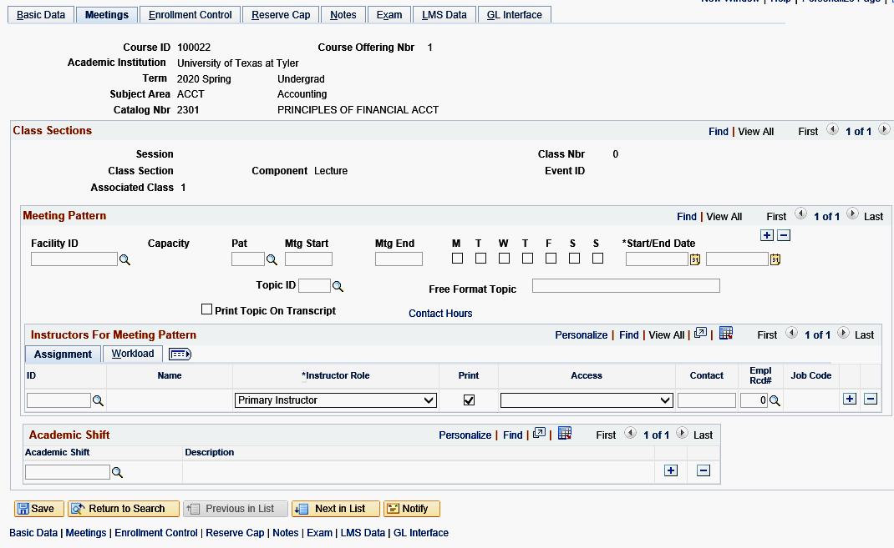
1. Introduction 2. Your First Class 3. Maintaining Classes 4. Room Selection
Schedule New Course | Basic Data | {Meetings} | Enrollment Cntrl | Reserve Cap | Notes
Meetings Tab
Meeting Pattern
The Facility ID - This field is populated by Ad Astra. Any data manually entered will be overridden by the data transfer process between Ad Astra and PeopleSoft. The room information is turned on prior to the next start date of any term.
The PAT - This field is to be used for courses following Standard meeting patterns (see slide 24 for standard meeting patterns). Each standard pattern is already preloaded in this dropdown. PeopleSoft checks the boxes based on the PAT selected. The checkboxes are only used for approved irregular or off-grid meeting patterns. Using the PAT field is also important as it will calculate the meeting end time based on the starting time in order to help ensure the course meets for the minimum required minutes in a semester.
Mtg Start/Mtg End - Used to enter the start time for a course. This field works best with military time, so 9:30AM would be 0930a instead. The end time will populate if using a Standard Meeting Pattern selecting the PAT field.
Day of the Week Checkboxes - The check boxes are automatically selected if the PAT field was used to select a standard meeting pattern. These boxes should only be checked if using an approved Non-standard pattern.

Slide 24
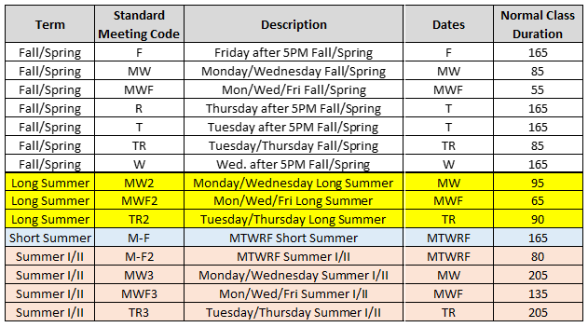
The standard meeting patterns are available by clicking the search button.
1. Introduction 2. Your First Class 3. Maintaining Classes 4. Room Selection
Schedule New Course | Basic Data | {Meetings} | Enrollment Cntrl | Reserve Cap | Notes

Slide 25
1. Introduction 2. Your First Class 3. Maintaining Classes 4. Room Selection
Schedule New Course | Basic Data | {Meetings} | Enrollment Cntrl | Reserve Cap | Notes
Meetings Tab
Meeting Pattern
Start/End Date - Input the time the class begins, and this field will auto populate the MTG Start/MTG End dates based on the dates for the session. This field can be manipulated for a course that has multiple meeting patterns. If the course meets on different dates and times, use this field to enter the date range that the meeting pattern applies to. Use the + sign to add additional meeting pattern rows.
Topic ID - Skip
Free Format Topic - This field will print on a student’s transcript. Please use discretion when using this field. It should be reserved for naming titles of special topic courses, or independent studies.
Print Topic on Transcript - Skip
Contact Hours hyperlink - Skip
Pro Tip:
All classes MUST follow a standard meeting pattern or receive prior approval from the Office of the Provost. Standard meeting patterns are on the next slide.

Slide 26
1. Introduction 2. Your First Class 3. Maintaining Classes 4. Room Selection
Schedule New Course | Basic Data | {Meetings} | Enrollment Cntrl | Reserve Cap | Notes
Standard Meeting Patterns
for 3 Credit Hour Courses Fall and Spring Semesters
Common Meeting Time:
The Provost has declared Thursdays from 12:30PM to 1:50PM to be a “Common Meeting time,” during which time no classes should be scheduled. Make sure that when you are scheduling a section that it does not fall within this time. The only exceptions are lab courses, and hybrid courses that meet face-to-face on Tuesday and then are online on Thursday.
*Freshman Level Courses (Catalog Nbr begins with a 1) MUST be scheduled for either a MWF or TR Meeting Pattern
Reminders:
3 credit hour classes must meet for a minimum of 2250 minutes per semester. This does include the time allotted for final exams.
Course times in the darker shaded boxes are considered night classes.
Course offerings for 3 credit hour courses outside the Standard Course Meeting Patterns must receive special approval from the Department Chair, College Dean, and Academic Affairs.
Standard total minutes of instruction per course:
For each semester credit hour earned, 750 minutes of instruction are required. The requirement is the same for Fall, Spring or Summer.
Standard Meeting Times
MWF |  | TR |  | MW |  | T-F
55 minutes |  | 80 minutes |  | 85 minutes |  | 165
Start | End | Start | End | Start | End | Start | End
8:00 AM | 8:55 AM | 8:00 AM | 9:20 AM
9:05 AM | 10:00 AM | 9:30 AM | 10:50 AM
10:10 AM | 11:05 AM | 11:00 AM | 12:20 PM
11:15 AM | 12:10 PM | No Scheduling
12:20 PM | 1:15 PM | 2:00 PM | 3:20 PM | 2:30 PM | 3:55 PM
1:25 PM | 2:20 PM | 3:30 PM | 4:50 PM | 4:05 PM | 5:30 PM
 |  | 5:30 PM | 6:50 PM | 5:40 PM | 7:05 PM | 5:00 PM | 7:45 PM
 |  | 6:00 PM | 7:20 PM | 6:00 PM | 7:25 PM | 6:00 PM | 8:45 PM
 |  | 7:00 PM | 8:20 PM | 7:00 PM | 8:25 PM
 |  | 8:00 PM | 9:20 PM | 8:00 PM | 9:25 PM
*Blue highlighted time blocks are considered night classes
1 credit hour = 750 minutes
2 credit hour = 1500 minutes
3 credit hour = 2250 minutes
4 credit hour = 3000 minutes
5 credit hour = 3750 minutes
6 credit hour = 4500 minutes

Slide 27
1. Introduction 2. Your First Class 3. Maintaining Classes 4. Room Selection
Schedule New Course | Basic Data | {Meetings} | Enrollment Cntrl | Reserve Cap | Notes
Meetings Tab
Instructors for Meeting Pattern
ID - Enter the instructors ID in the field. It is always easier to have the instructor's identification number on hand to ensure the appropriate person is selected. Using the magnifying glass will allow a search for the instructor but searching on a name basis only can prompt an accidental selection of a similar name but could be someone other than the instructor.
Instructor Role - Every course must have at least one Primary Instructor. The values in this field are Primary, Secondary, and TA. Primary instructors should be listed first. If a course does not have a primary instructor, grade rosters will not be generated. If a course does not have any instructor, it will not appear in the Bookstore Report. Please ensure that if selecting TA, the TA has met all the requirements of a TA.
Print – Leave checked.
Access - Select Approve access for the Primary Instructor of record. All courses must have a Primary Instructor with Approve access. Approve means the instructor can enter grades and approve the grade roster. Grade means the instructor can only enter grades for the class. Grade access allows the grades to be entered but not approved. The Registrar’s Office will be unable to post grades if there is not a primary instructor with approve access. Post is not used. Grade posting is processed by the Office of the Registrar.
Pro Tip:
All sections must have at least one instructor with an Instructor Role of Primary Instructor and Approve Access!
Make sure all new or returning adjunct instructors have both the UTT_CS_FACULTY_MISC and UTT_CS_SS_INSTRUCTOR roles, by submitting an IT Support ticket.

Slide 28
1. Introduction 2. Your First Class 3. Maintaining Classes 4. Room Selection
Schedule New Course | Basic Data | {Meetings} | Enrollment Cntrl | Reserve Cap | Notes
Meetings Tab
Contact - Skip
Empl Recl# - Skip
Job Code - Skip
Plus and Minus Icons - Notice the + and – icons, this is how you will add an instructor if there is more than one. It is also how you will remove an instructor. Instructors should always be removed by using the minus sign to do so. Overtyping or backspacing the instructor ID on an existing row will not delete the previous instructor information.
Meeting Pattern
Pro Tip:
To replace an Instructor, use the minus - sign to delete the row. Overtyping the ID field or backspacing the existing data out will not remove the instructor from the course.

Slide 29
1. Introduction 2. Your First Class 3. Maintaining Classes 4. Room Selection
Schedule New Course | Basic Data | {Meetings} | Enrollment Cntrl | Reserve Cap | Notes
Meetings Tab
Meeting Pattern
Workload Tab - When the class section has only one meeting pattern and one instructor, the system defaults the correct information in this area. Adjustments are only needed here when a class has multiple meeting patterns or multiple instructors. The only fields to be adjusted by academic departments are the Assign Type and Load Factor fields. The Workload, Auto Calc, and Assignments FTE% will be populated by the system and should be left as is.
Assign Type - There are two choices in the drop-down box, Teaching and NotInclud. The teaching instructor(s) will get Teaching. There can be more than one instructor teaching a course. An additional instructor that is not teaching, such as a Department Chair, will have the Assign Type as NotInclud.
Load Factor - When a course has a single meeting pattern and a single instructor the system defaults to the correct information.
When a course has a single meeting pattern but two teaching instructors, provide the appropriate percentage to reflect the amount of time each teacher will be teaching the course.
When there are multiple meeting patterns the top meeting pattern row should hold all of the credit. The first row will hold the Teaching Assign Type and the Load Factor percentage. Every additional row will be set to NotInclud on the Assign Type and 0.0001% Load Factor.

Slide 30
1. Introduction 2. Your First Class 3. Maintaining Classes 4. Room Selection
Schedule New Course | Basic Data | {Meetings} | Enrollment Cntrl | Reserve Cap | Notes
Meetings Tab
Examples of Instructor and Meeting Pattern Configurations
One Meeting Pattern row shown with the single pattern receiving the Load Factor credit and the correct Assign Type of Teaching.
Multiple Instructors both with Teaching as Assign Type. The department makes the decision as to the amount of Load Factor each instructor should receive when there are multiple instructors assigned to a course.
Multiple Instructors one with Teaching and one with NotInclud.

Slide 31
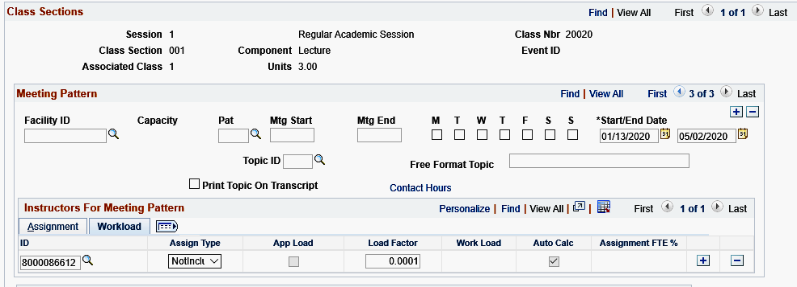
1. Introduction 2. Your First Class 3. Maintaining Classes 4. Room Selection
Schedule New Course | Basic Data | {Meetings} | Enrollment Cntrl | Reserve Cap | Notes
Meetings Tab
Examples of Instructor and Meeting Pattern Configurations
Multiple Meeting Pattern rows shown with the correct format of the first row holding all of the credit and the subsequent rows placed on NotInclud and given the 0.0001 Load Factor.

Slide 32
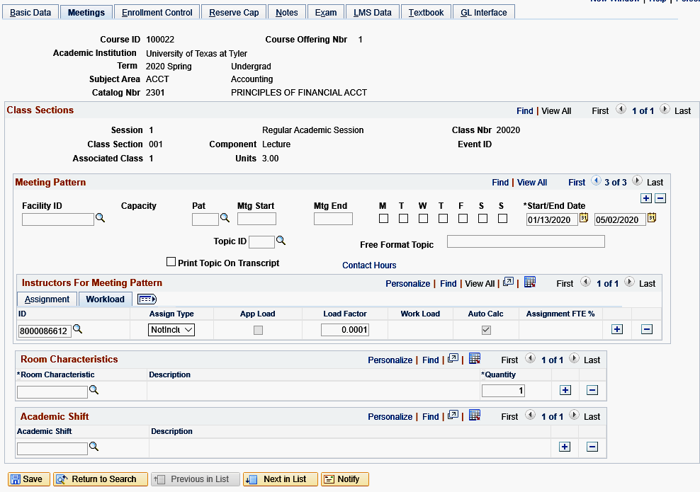
1. Introduction 2. Your First Class 3. Maintaining Classes 4. Room Selection
Schedule New Course | Basic Data | {Meetings} | Enrollment Cntrl | Reserve Cap | Notes
Meetings Tab
Room Characteristics
This field allows the selection of ITV to be made. Select this for both sections of a Zoom class (sending and receiving.)
Academic Shift
Skip.

Slide 33
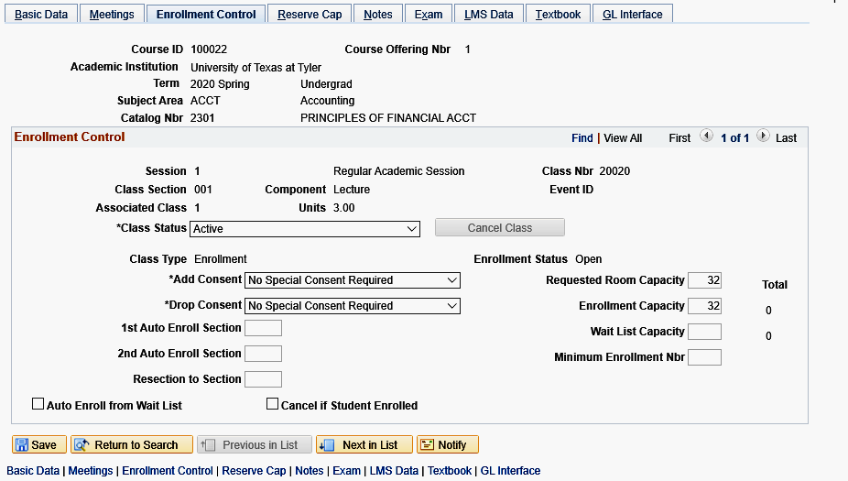
1. Introduction 2. Your First Class 3. Maintaining Classes 4. Room Selection
Schedule New Course | Basic Data | Meetings | {Enrollment Cntrl} | Reserve Cap | Notes
Enrollment Cntrl Tab
Enrollment Control
To control enrollment, select the class status from the Class Status drop down menu. The available selections are Active, Stop Further Enrollment, or Tentative Section. This field has a default status value of Active. Only the Active status allows registration in the class. Classes with a status of Tentative will not display in Class Search.
Canceling Classes
When you know you need to cancel a class, the first step is to set it as “Stop Further Enrollment.” Refer to “Course Cancellation Process” (page 39 of this document) for instructions on how to request the cancellation of a course.
The Add Consent field value defaults from the Course Catalog. This value may be overridden by selection from the drop-down menu. The available values are No Consent, Dept. Consent, and Inst. Consent. Courses with restricted entry such as independent studies, courses unpublished in schedule, internships, etc. should be marked for either Dept. or Inst. Consent. Permission numbers are generated for all classes marked for consent.
DO NOT use the Drop Consent field; this value must always remain as ‘No Consent’.
The Enrollment Capacity field sets the maximum number of students allowed to enroll in each section. Type the number of seats wanted for the classroom to override the default value for the Requested Room Capacity, which is derived from the Default Section Size value in the Course Catalog. These two numbers should always remain the same.
All other fields are not used at UT Tyler and can be skipped.
Pro
Tip:
The Enrollment Capacity value must be reflective of the actual enrollment capacity for each course and is subject to administrative review. Please do not leave the default value.

Slide 34
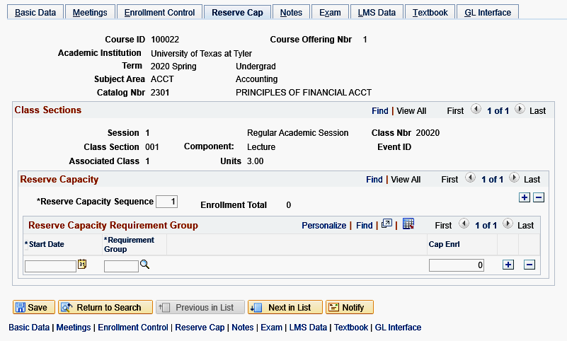
1. Introduction 2. Your First Class 3. Maintaining Classes 4. Room Selection
Schedule New Course | Basic Data | Meetings | Enrollment Cntrl | {Reserve Cap} | Notes
Reserve Cap Tab
Reserve Cap
This step is not required and should only be used to reserve space in a class for a specific requirement group (ie Student Learning Communities or a Student Group).
Before a reserve capacity can be set the Registrar’s Office must build a Requirement Group. This defines who is eligible to enroll in the class. If the requirement group you need is not in the search field, please contact the AcademicScheduling@uttyler.edu to create one.
To add a Reserve Cap
Input the effective date that the requirement group can begin registering in the Start Date field or click the calendar icon to select a date.
Type in the Requirement Group, meeting desired specifications in the Requirement Group field or click the magnifying glass to lookup the values.
Enter the maximum number of seats to reserve for students who meet the Requirement Group in the Cap Enrl field and click save.
If a Reserve Cap is placed on a section be sure to determine how many reserved seats are needed. Sometimes it will be the max capacity of the course, sometimes it will not be. If enrollment on the course section is increased or decreased be sure to also change it here.
Pro Tip:

Slide 35
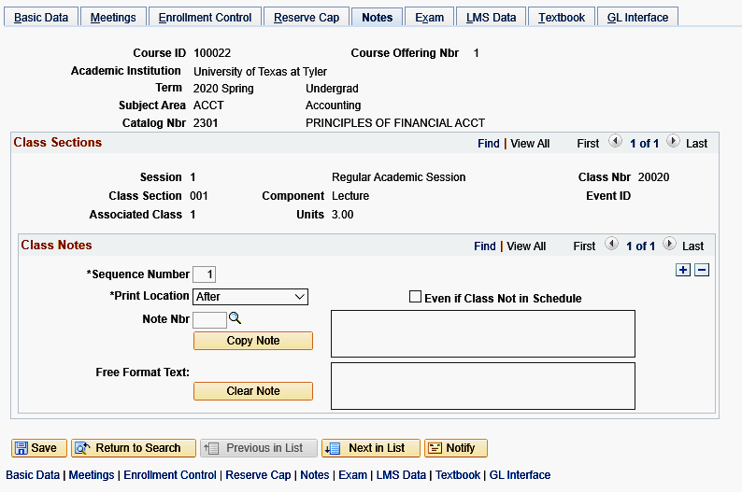
1. Introduction 2. Your First Class 3. Maintaining Classes 4. Room Selection
Schedule New Course | Basic Data | Meetings | Enrollment Cntrl | Reserve Cap | {Notes}
Notes Tab
Notes
The Notes Tab is for specific class notes. Each note is displayed on the detail for the specific class section to which it is attached. Notes are optional. The Sequence Number is defaulted to 1 and determines the display order of the note if there are multiple notes. The Sequence Number can be overridden, and notes can be placed in order of importance or relevance.
If the same note is being placed on sections of a course repetitively from semester to semester, please contact AcademicScheduling@uttyler.edu to see if a standard note could be added.
Print Location - This sets the print location of the note either Before the class listing or After it.
Note Nbr - Use this search to attach a pre-existing standard note. Selecting an item from the list will populate the adjacent field with the detail.
Free Format Text - Use this to enter notes for classes and click save.
The remaining tabs (Exam, LMS Data, Textbook, GL Interface)
should be skipped.
Pro Tip:
To modify the existing note, press copy note. The text will be copied to the Free Format Text area and eliminated from the previous area. The note number will also be erased.

Slide 36
1. Introduction 2. Your First Class 3. Maintaining Classes 4. Room Selection
Possible Changes | Combined Sections | Course Cancellation
Maintaining Classes Once They are Created
Possible Changes | Combined Sections | Course Cancellation

Slide 37
1. Introduction 2. Your First Class 3. Maintaining Classes 4. Room Selection
{Possible Changes} | Combined Sections | Course Cancellation
What can be changed now that the class has been scheduled
After Registration Has Opened
Based on scheduling procedure, you can only change a few details for your newly created section.
You CAN Change:
Class Attributes
Instructors/Instructor workload
Enrollment capacity and room capacities
Combined and uncombined courses
Class Status (Active/Tentative/Stop Further Enrollment)
You CANNOT Change:
Meeting patterns
Session
Location
Instruction Mode
Class Association Number
✓
Before Registration Has Opened
You can change almost anything!
You can go back and change or update the fields in PeopleSoft that you initially entered when you created the section.
So, for example, if you needed to change the section number, a professor, a meeting pattern – all of these could be changed, as long as registration has not yet begun for the session in which your section is scheduled.
✗
Any of these “cannot changes” will require the cancellation and rescheduling of any affected sections – see “Course Cancellation Process” on page 39.
Pro Tip:
You should not change the section number after registration has opened. If you feel you need to change it, please contact AcademicScheduling@uttyler.edu.

Slide 38
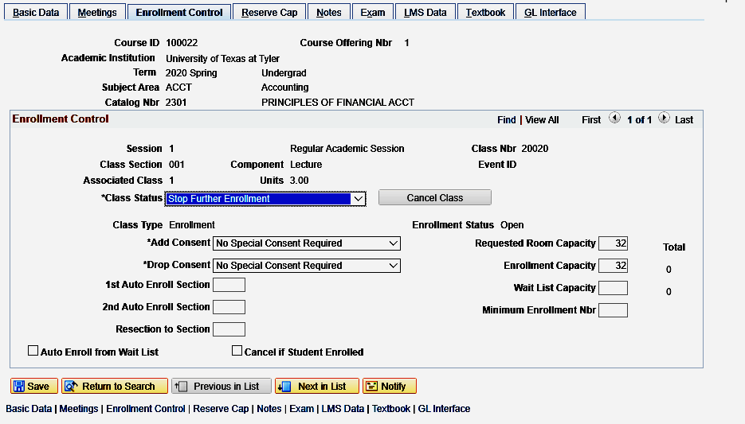
1. Introduction 2. Your First Class 3. Maintaining Classes 4. Room Selection
Possible Changes | Combined Sections | {Course Cancellation}
Course Cancellation Process
Course Cancellation
Only the Office of the Registrar is allowed to cancel classes in PeopleSoft.
To request the cancellation a course:
Set the Class Status to Stop Further Enrollment.
Obtain an email from the Department Chair confirming the request to cancel the course.
Forward the email to AcademicScheduling@uttyler.edu. The following information must be included for the cancellation request to be processed:
Class subject
Catalog number
Term
How many students are enrolled
Confirmation that the students have been notified of the cancellation. This is extremely important, as once a cancellation is processed, access to the roster of students is no longer available.
If the course or section to be cancelled is part of a Combined Sections Table, remove it from that entry before proceeding with the cancellation request.
Once the course has been cancelled an email will be sent by AcademicScheduling@uttyler.edu confirming the cancellation. The Dean, Bookstore, and department admin will be copied on the email. This is standard procedure.

Slide 39
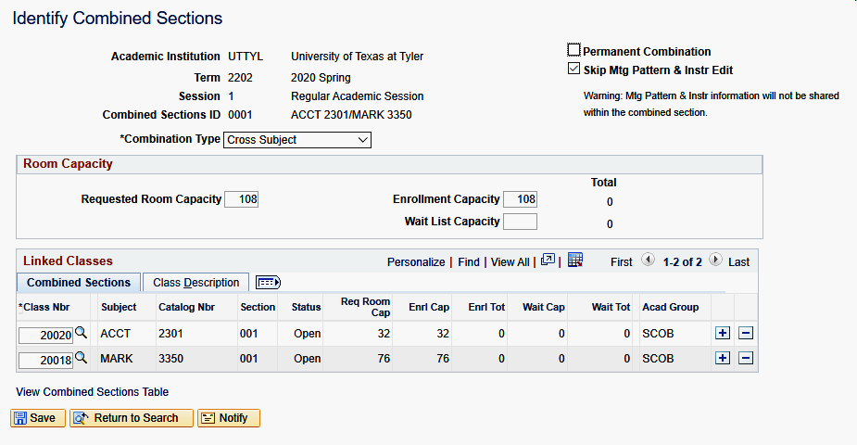
1. Introduction 2. Your First Class 3. Maintaining Classes 4. Room Selection
Possible Changes | {Combined Sections} | Course Cancellation
Combining and Uncombining Sections
Combining and Uncombining Sections
Enter all the course information for the sections you wish to combine as these are scheduled normally. Be sure to write down the 5-digit Class Number for all the sections that are being combined. You may not combine a face-to-face section and an online section.
To Combine Sections:
Navigate to Curriculum Management>Combined Sections>Combined Sections Table, enter the relevant Term and choose the Session.
Click on Search to bring up the table. Click on the plus + sign to add a new row. Put the SUBJ and Course Number of the classes being combined in the “Description” column. Enter a short but meaningful Short Description. Be sure to SAVE at the bottom of the table which then creates a live “View Combined Sections” hyperlink.
Click on the View Combined Sections hyperlink. This will pull up the Identify Combined Sections page. Here, choose a combination type, (Within Subject if the course prefixes are the same, Cross Subject if they are different.)
Click the Permanent Combination checkbox if this will always be cross-listed. This is optional.
Always check the Skip Mtg Pattern and Instr Edit checkbox. This allows the logic in the State Reports to run correctly, so these checkboxes must always remain checked.
(continued on next page)

Slide 40
1. Introduction 2. Your First Class 3. Maintaining Classes 4. Room Selection
Possible Changes | {Combined Sections} | Course Cancellation
Combining and Uncombining Sections (cont’d)
Combining and Uncombining Sections
To Combine Sections (continued):
Enter the requested room capacity and enrollment capacity for each combined section. These two numbers should match and be sure to account for the capacity in total for all sections.
Requested Room Capacity is self calculated by adding both courses requested room caps. If one section has 15 and another has 30, the capacity should be 45.
Enter the 5 digit Class Nbr of all the sections to be combined under the Combined Sections tab.
Click the SAVE button. Sections are not actually combined until all steps are complete and it is saved.
If you ever need to change or enter meeting patterns or instructors for combined sections, you must do this via Curriculum Management>Schedule of Classes>Schedule Class Meetings.
To Uncombine Sections:
Navigate to Curriculum Management>Combined Sections>Combined Sections Table and click on the View Combined Section hyperlink to be uncombined. This will load the Identify Combined Sections page.
You must use the minus sign on the Identify Combined Sections page after you have clicked the hyperlink in order to uncombine the sections. This is necessary before one or more of the sections can be cancelled. (Removing the classes by using the minus sign in the original table list will not uncombine them – it will remove the hyperlink, meaning you will then never be able to uncombine them.)

Slide 41
Contact Information
Feel free to contact us at AcademicScheduling@uttyler.edu should you have questions about the Schedule of Classes, working with PeopleSoft, or scheduling academic course space in Astra.
Maggie Sorrell
Academic Scheduling Assistant
903-565-5919 | AcademicScheduling@uttyler.edu

